Slide 1
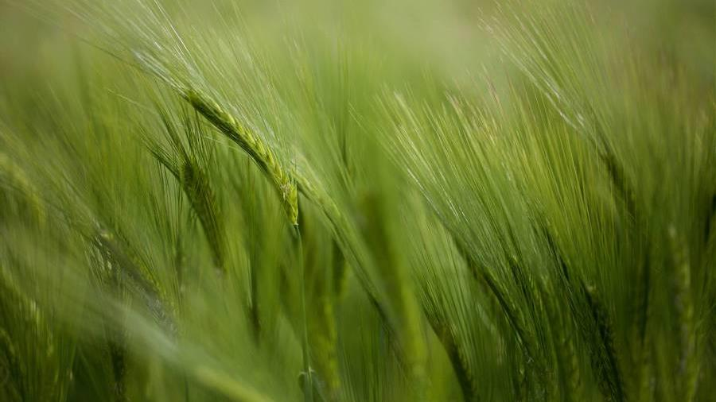
Soil Lab
Keegan Cougill
Brady Turner​​

Slide 2
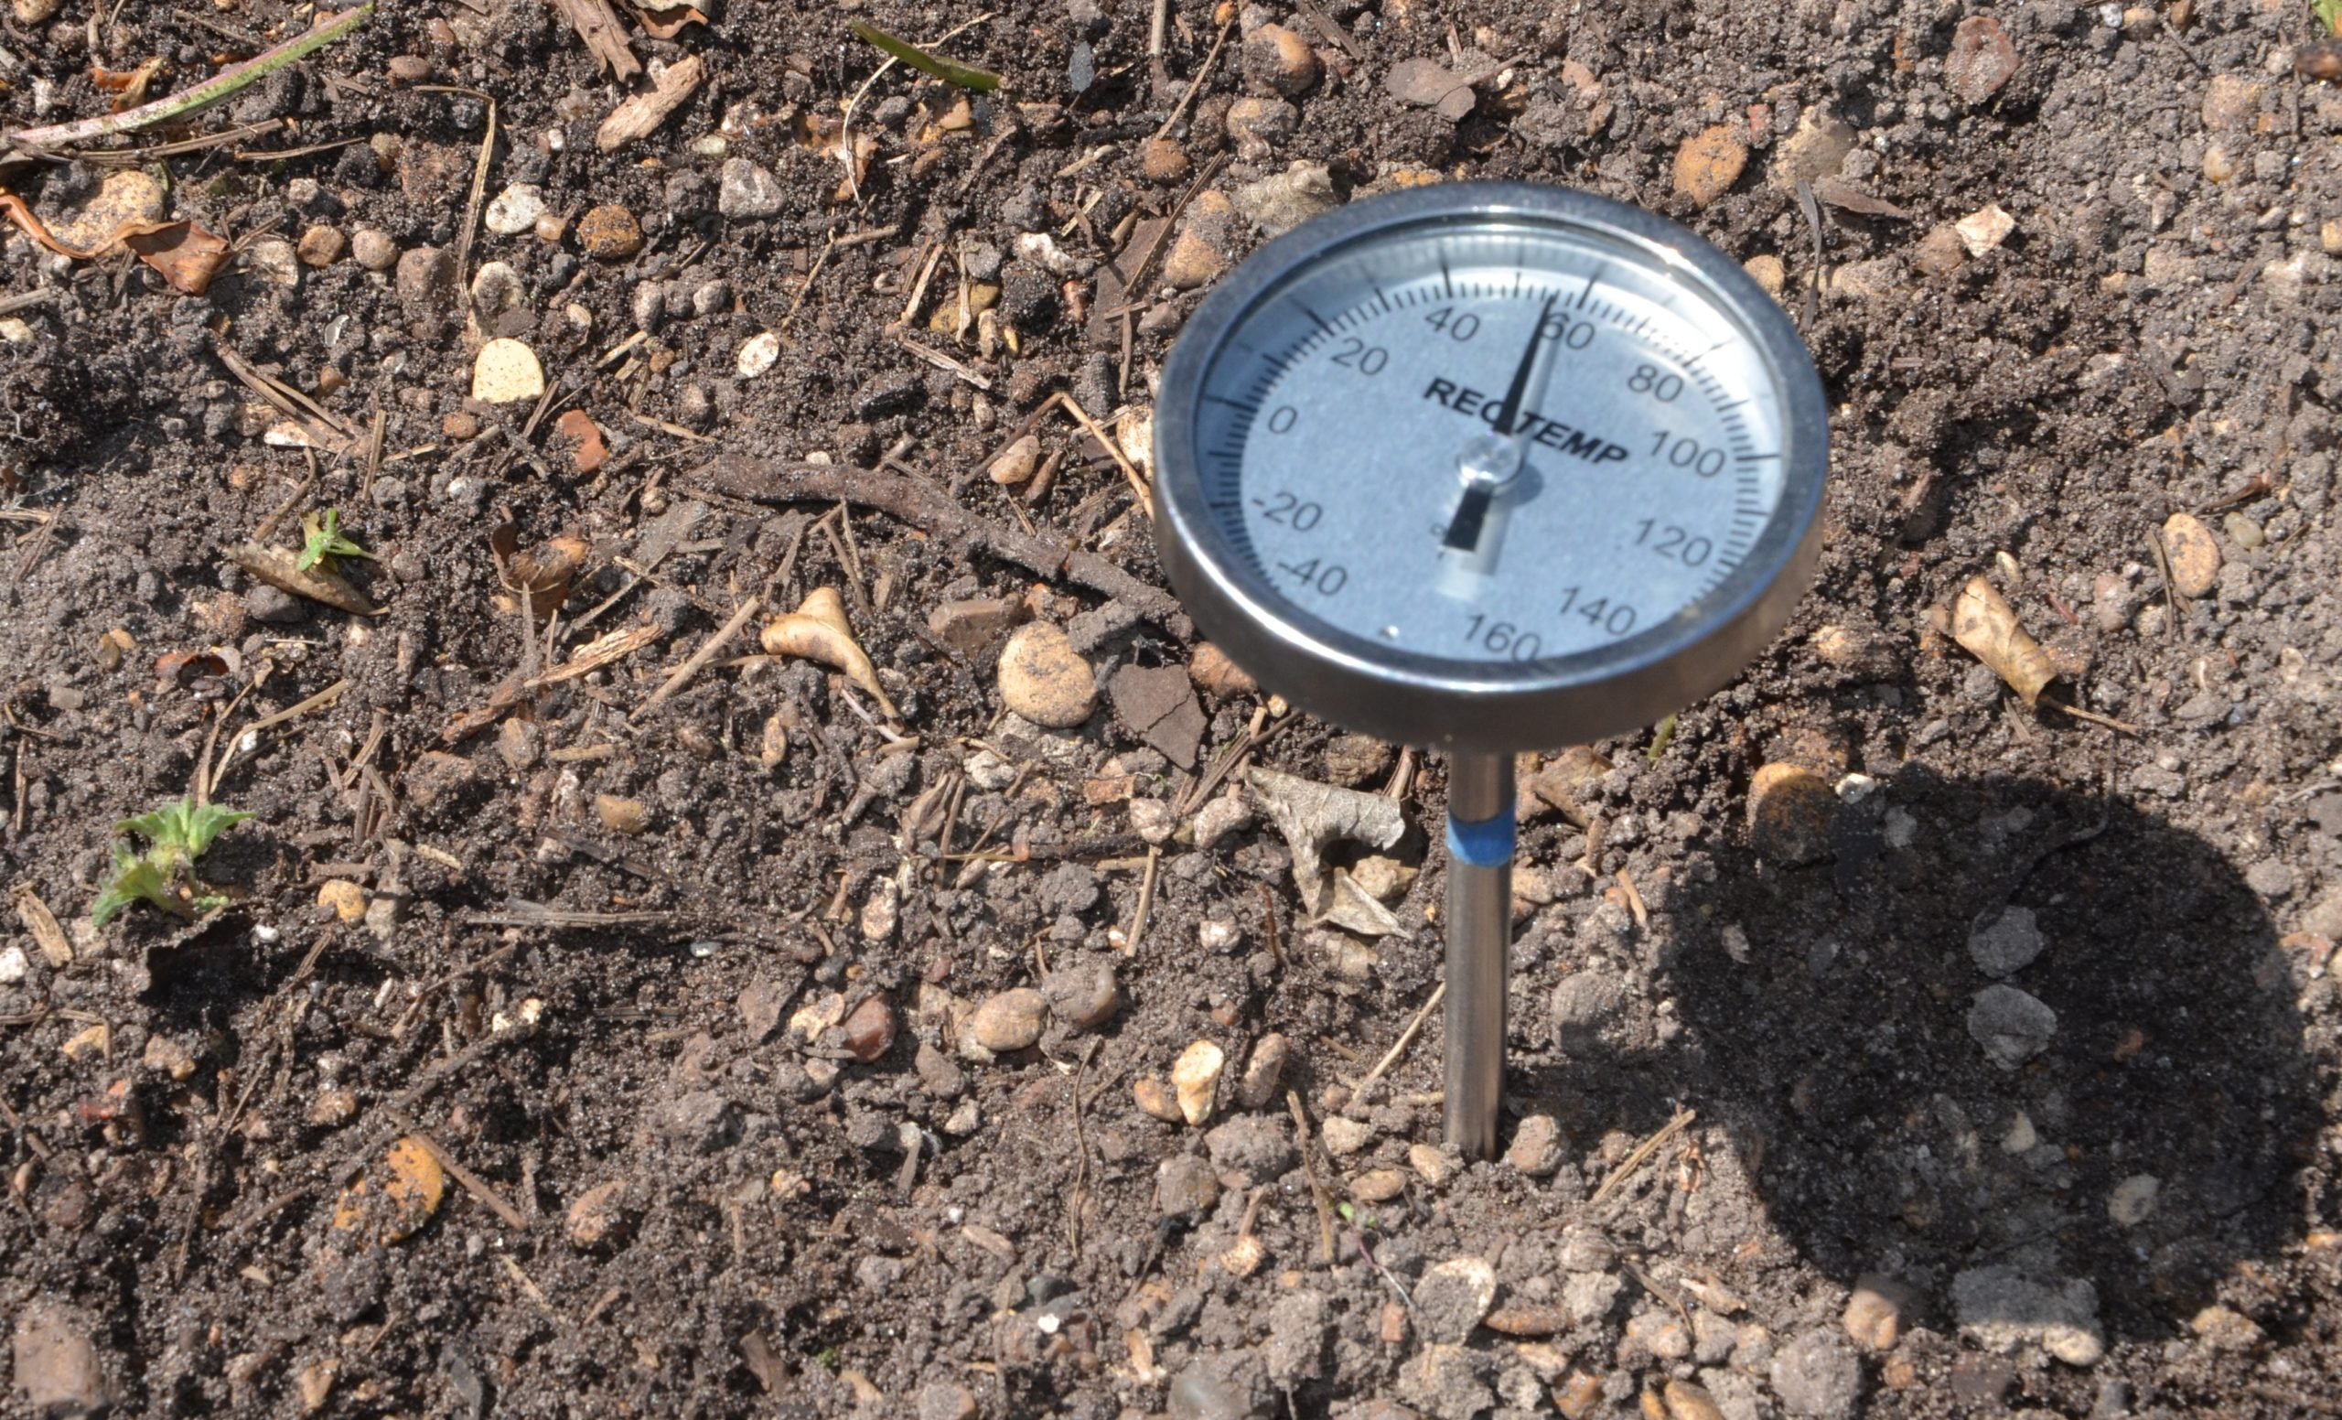
Temperature
Soil temperature is incredibly important. It's the measure of how warm or cold the soil is, and it affects everything from plant growth to ecosystem health. Various factors like climate, sunlight, and moisture impact soil temperature. Understanding and monitoring soil temperature is crucial for fields like agriculture, ecology, climate science, and engineering. Let's dive into why soil temperature matters and its significance in different areas.

Slide 3
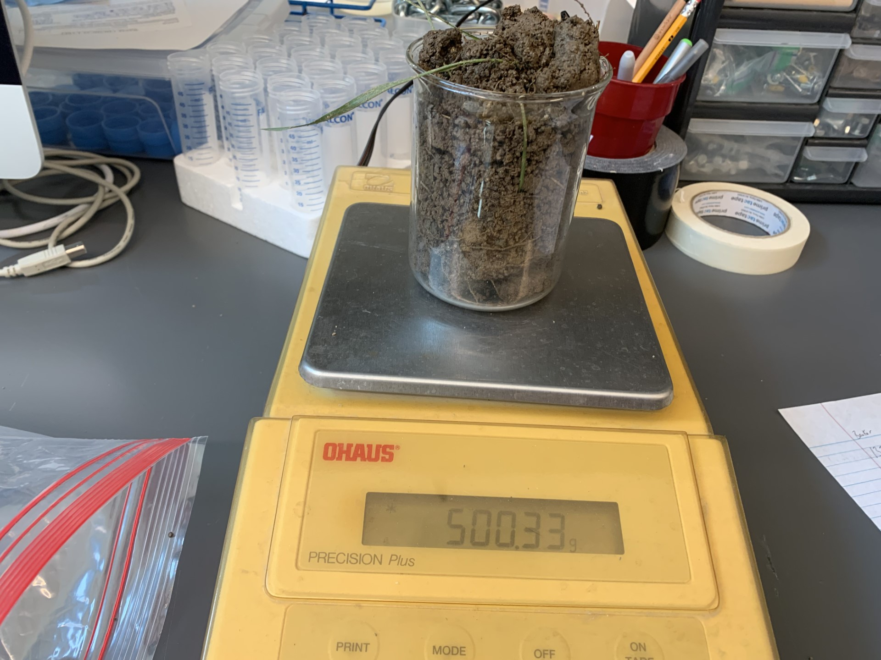
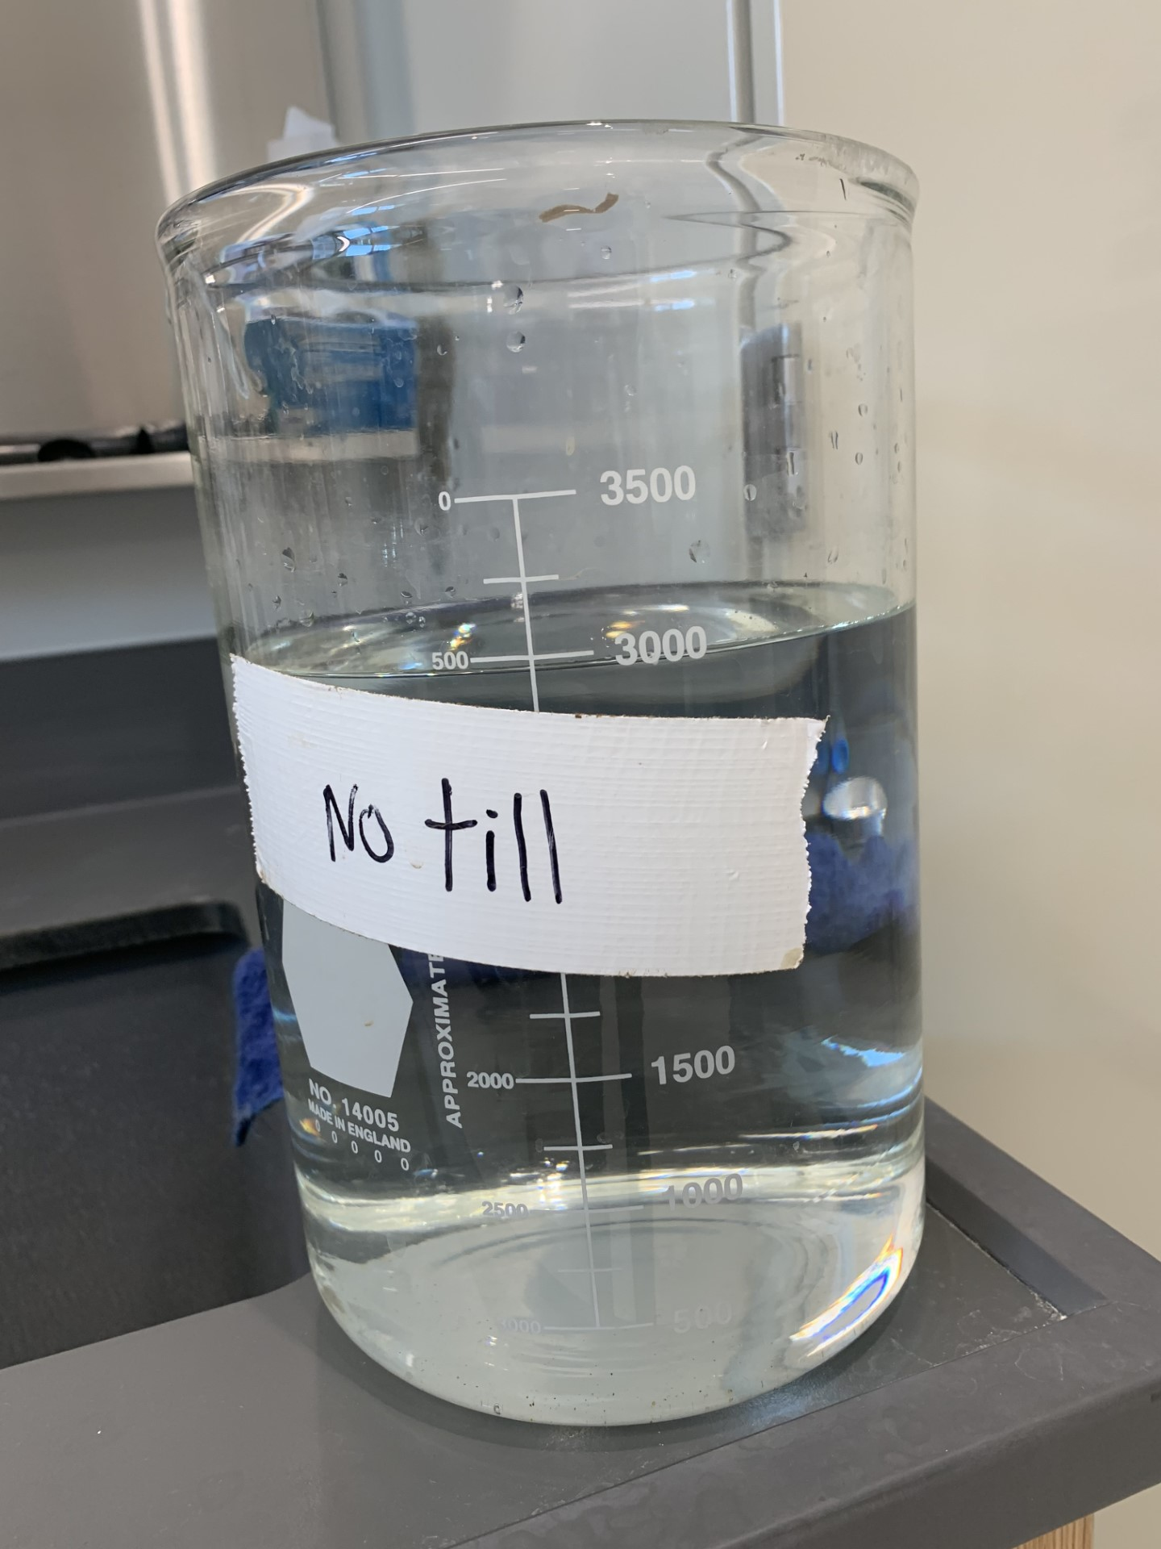
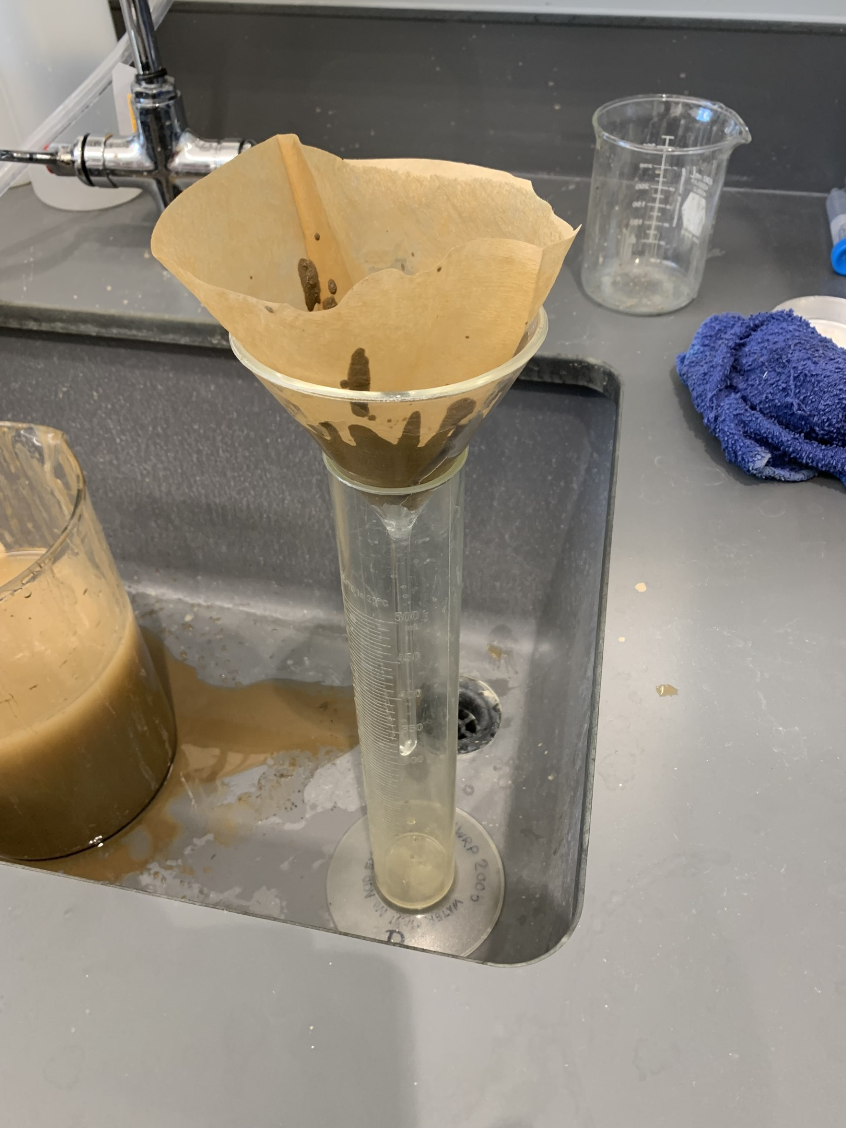
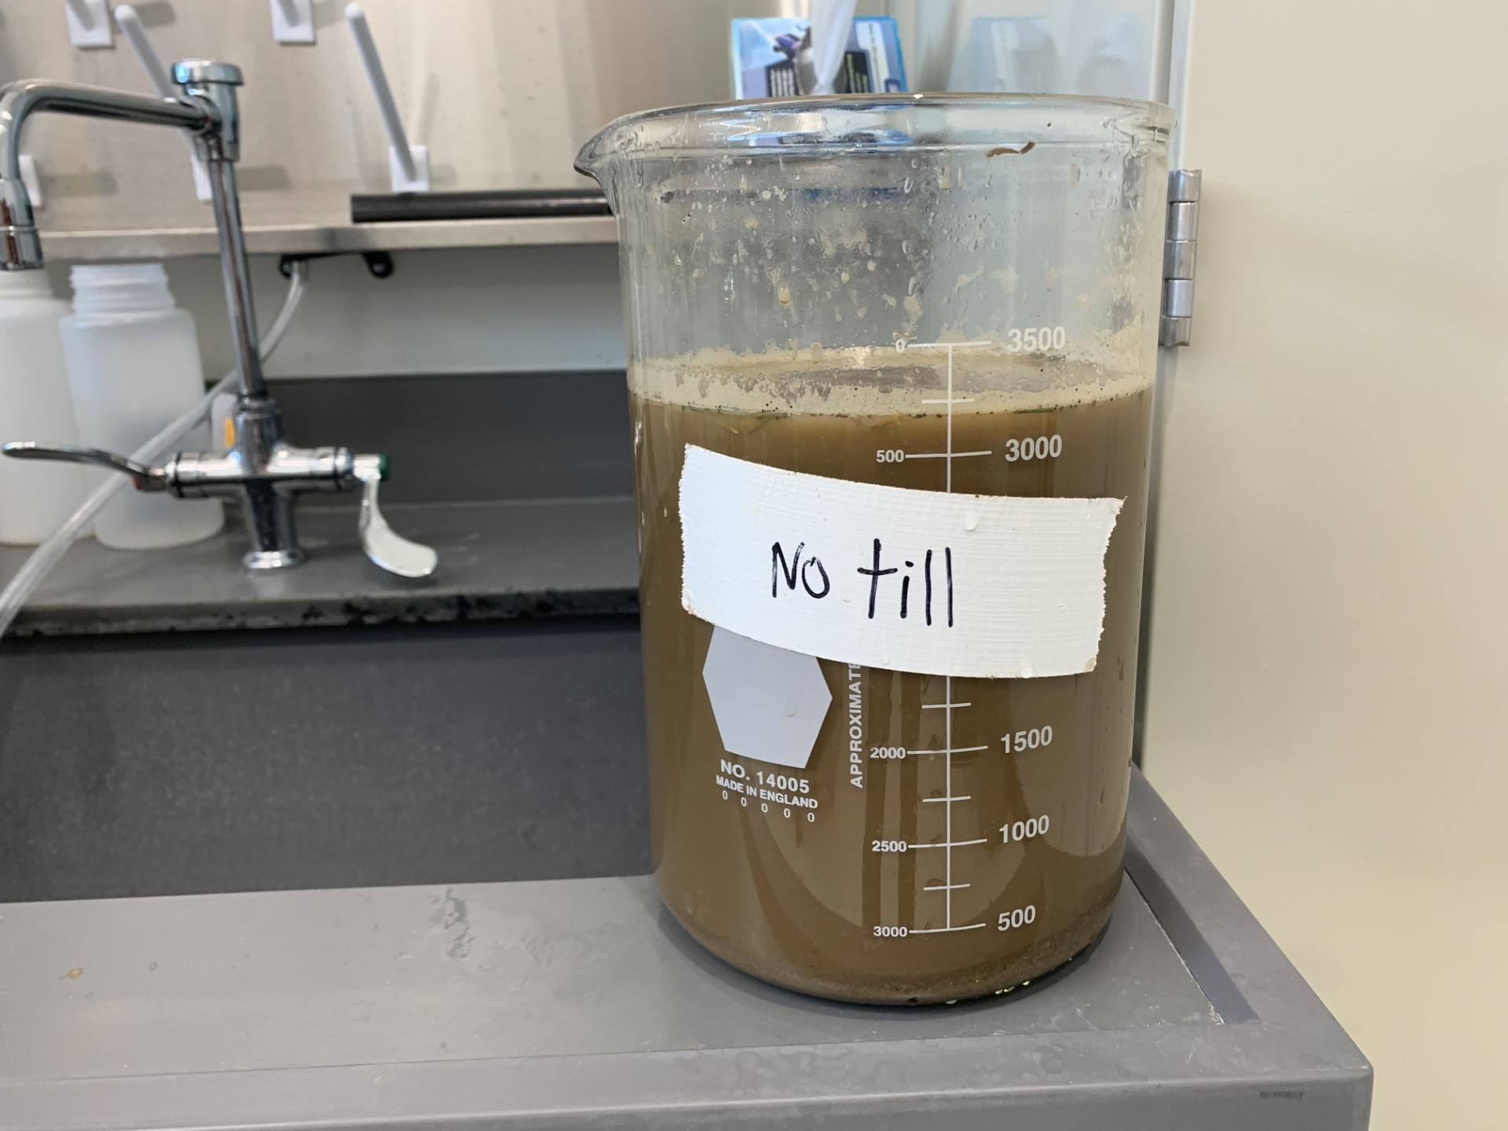
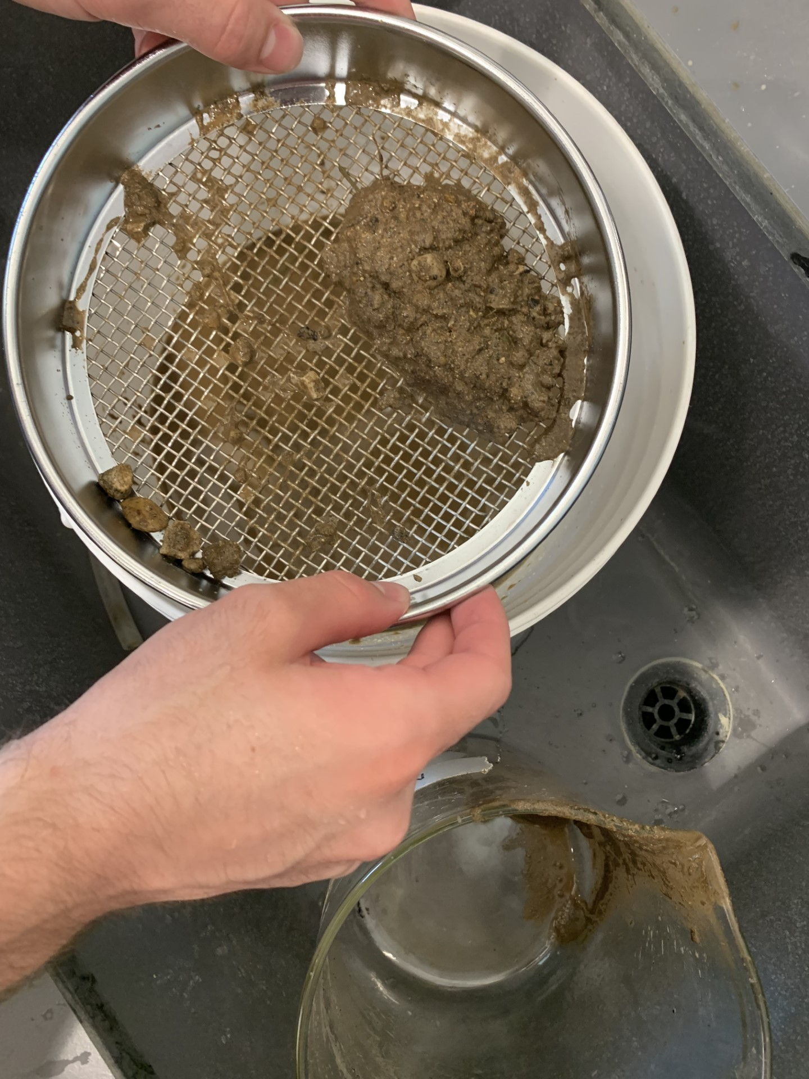
Soil Microorganism Survey
Step 1:
Acquire 500 g of Dirt from the top 6 inches of soil. As well as 3000 ml of Tap water
Step 3:
Pour the soil-animal mixture “slurry” onto the filter. The nematodes will be caught in the filter. Drain the water and let it sit overnight. The nematodes will sink to the bottom. The next day, take a few ml of the nematode water using a pipette on a microscope slide. Observe and record your findings.
Step 2:
Mix the solution by hand to break up large dirt clods. Using a sieve or a medium mesh screen, separate the large particles from the solution by pouring the solution through the strainer into a 2nd container. Then repeat with a finer mesh screen.

Slide 4
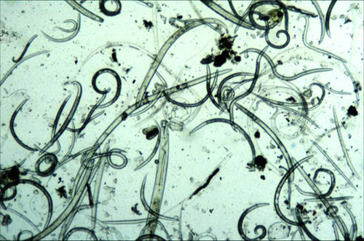
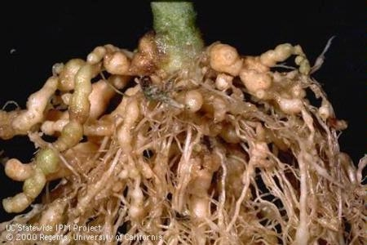
Nematodes
Common Nematodes
In the Midwest, several common species of nematodes can be found, each with specific impacts on different crops and environments. One prevalent nematode is the turf nematode, which affects lawns and grassy areas, leading to thinning and weakened turf. The corn nematode and soybean nematode poses a significant threat to corn crops, feeding on roots and causing reduced nutrient uptake and yield loss. These nematode species require proper management and monitoring strategies to minimize their negative impact on crop productivity to maintain agricultural industries.
"If all the matter in the universe except the nematodes were swept away, our world would still be dimly recognizable ... we should find its mountains, hills, vales, rivers, lakes, and oceans represented by a film of nematodes.”
-Nathan A Cobb
4/5 animals are nematodes

Slide 5

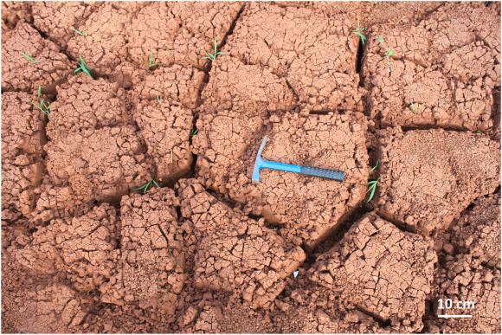
Desiccation
(drying)
Desiccating soil samples, or drying them out, is important for determining the percentage of moisture in the soil. By removing the water content through drying, we can accurately calculate how much moisture is present. This information is valuable in agriculture, ecology, and geology. It helps us understand soil fertility, how much water is available for plants, and the overall health of ecosystems. Knowing the moisture percentage helps make informed decisions about irrigation, soil composition, and land management.
Mass of Dish (g) | Soil +Dish (before dried) (g) | Soil+ Dish (after dried) (g) | Water evaporated | % moisture
22.756 g | 31.443 g | 30.783 g | .66 g | 7.6 %

Slide 6
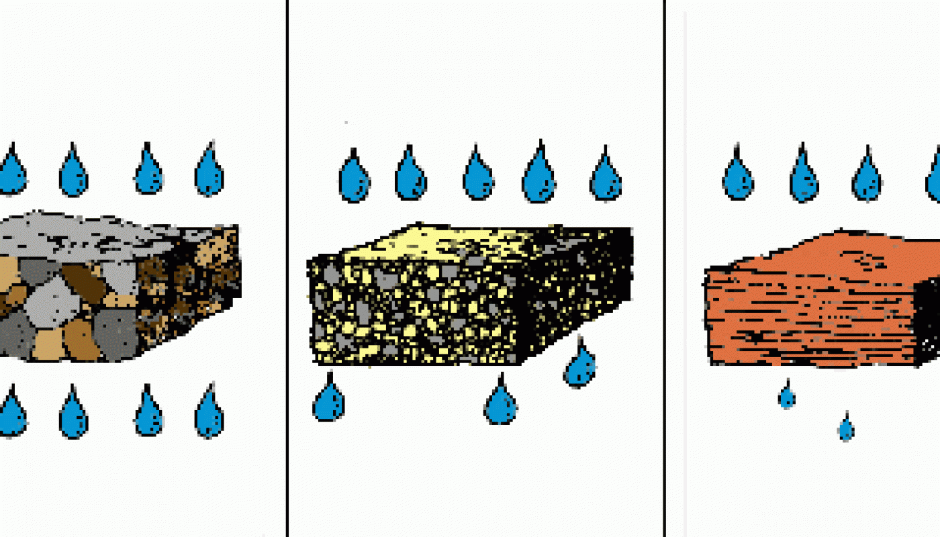
Permeability
research
Testing the permeability of soil is important because it tells us how easily water can move through it. Permeability helps us understand if the soil drains quickly or slowly. This information is useful in agriculture to decide how much water to use for irrigation and avoid waterlogging. It's also helpful in construction and engineering to design effective drainage systems and foundations. By testing soil permeability, we can protect groundwater from contamination and ensure the health of ecosystems. Overall, it helps us make smart decisions for land management and environmental sustainability.​

Slide 7
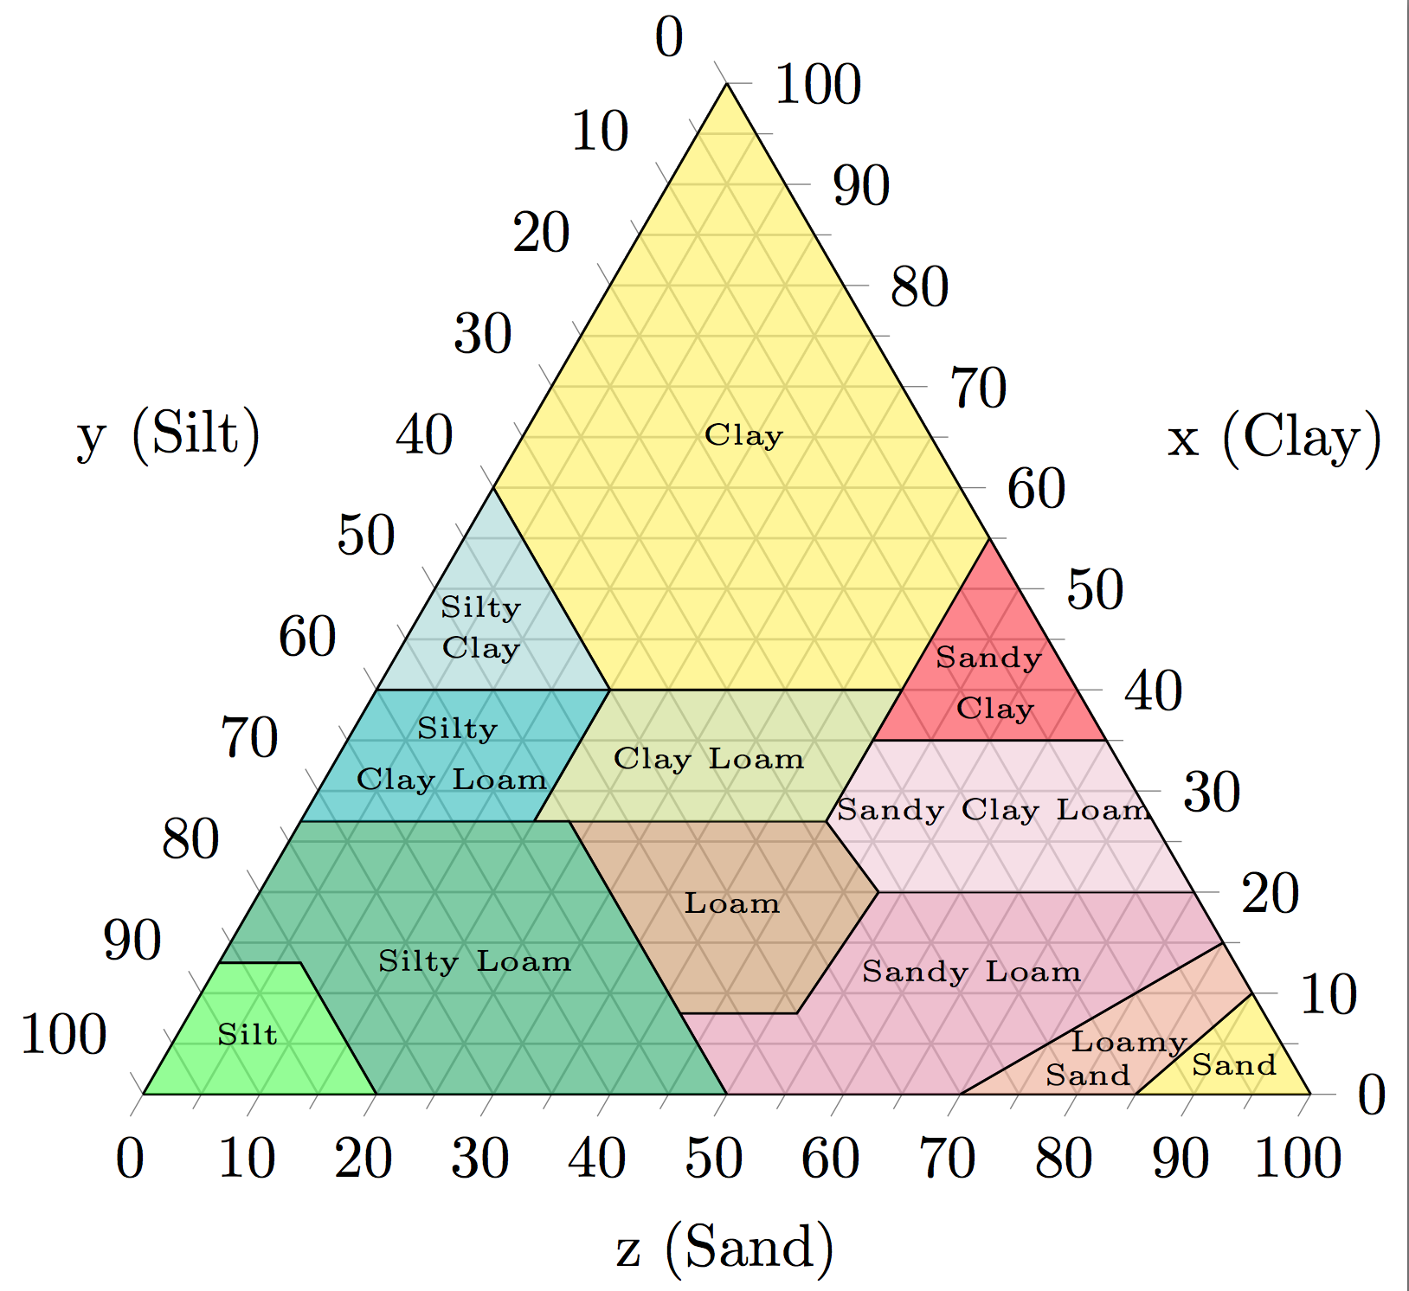
Soil Structure
Sand, classified as sediment particles ranging from 0.05 to 2 millimeters in size, plays a crucial role in soil structure. It enhances drainage, prevents compaction, and facilitates root growth by creating pore spaces for water and oxygen.
Sand​
Silt, classified as sediment particles ranging from 0.002 to 0.05 millimeters in size. Its smaller particles results in improved water and nutrient retention. However, excessive silt content can lead to soil compaction and reduced aeration.
Silt
Clay, with particle sizes measuring less than 0.002 millimeters, significantly influences soil structure. It has excellent water and nutrient retention capabilities, but it can lead to compaction and poor drainage​
Clay
This Photo by Unknown Author is licensed under CC BY-SA

Slide 8
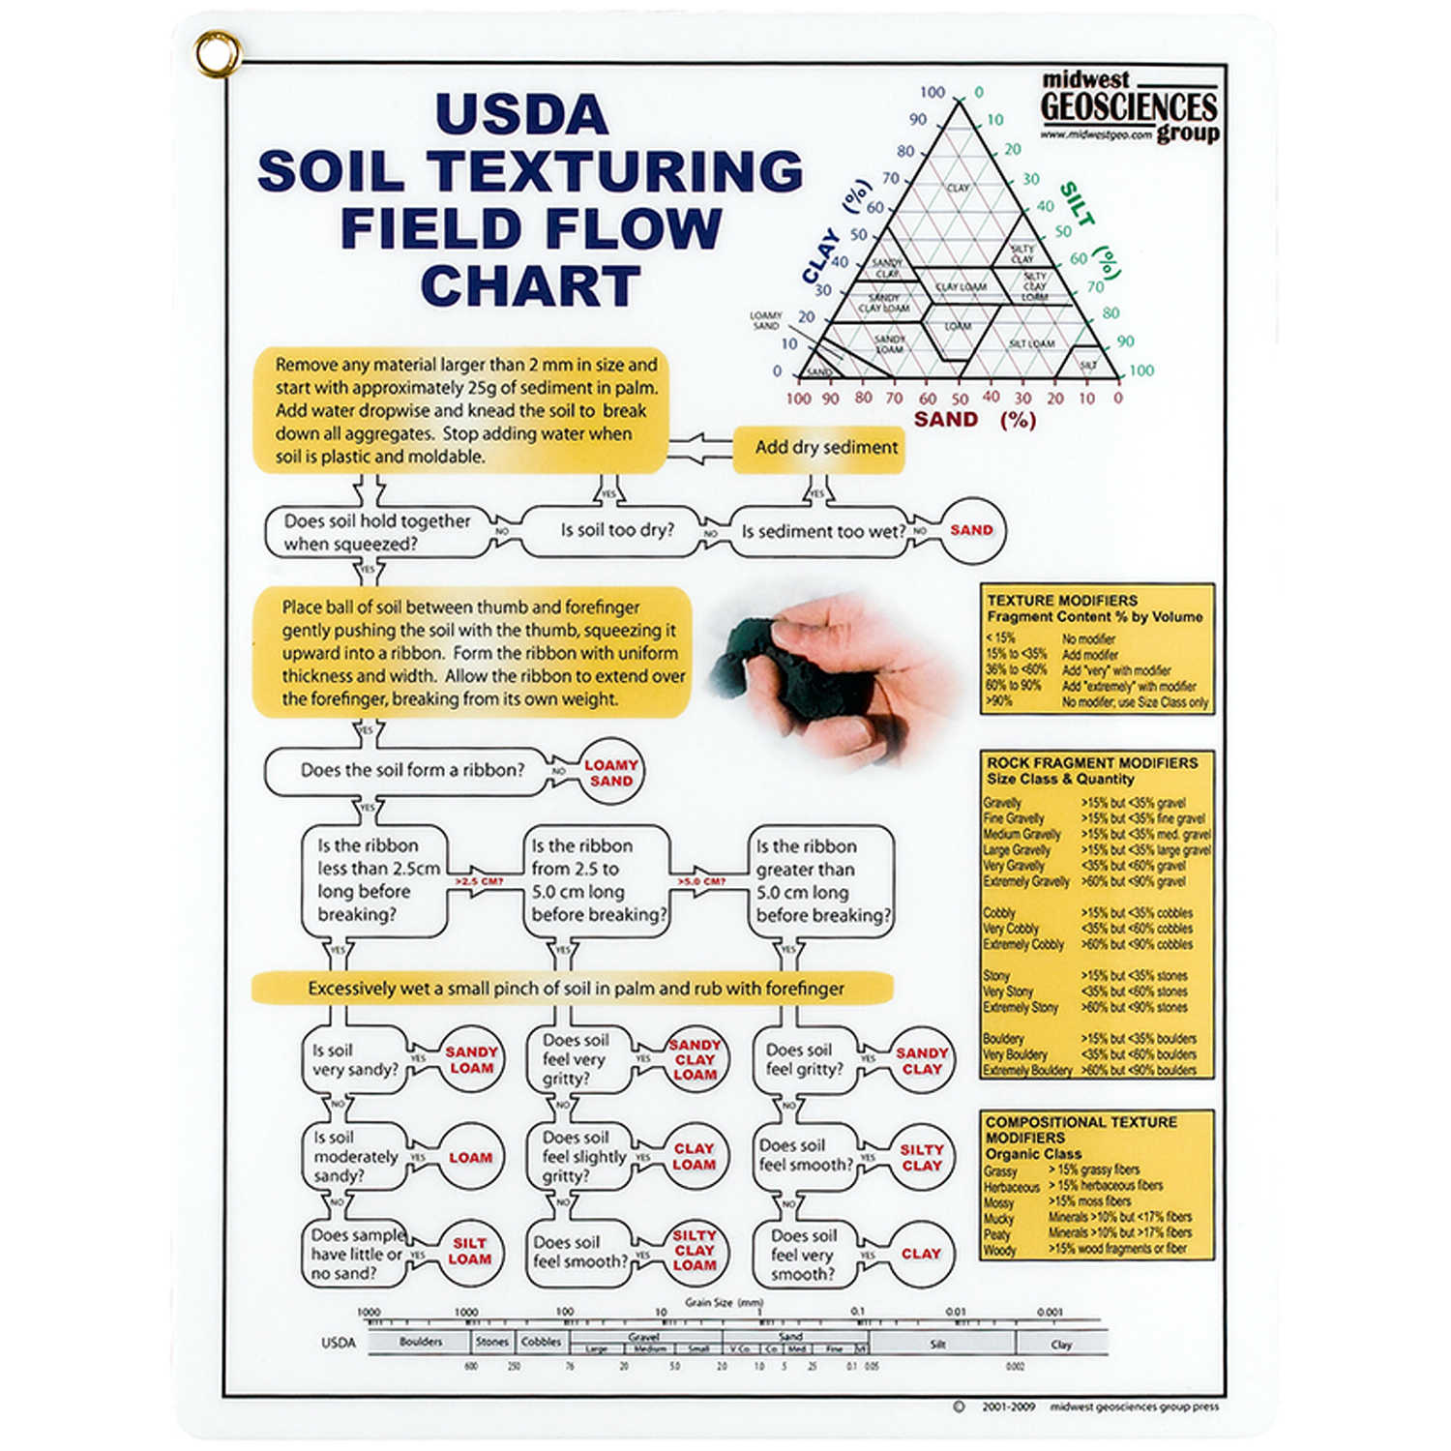

Slide 9
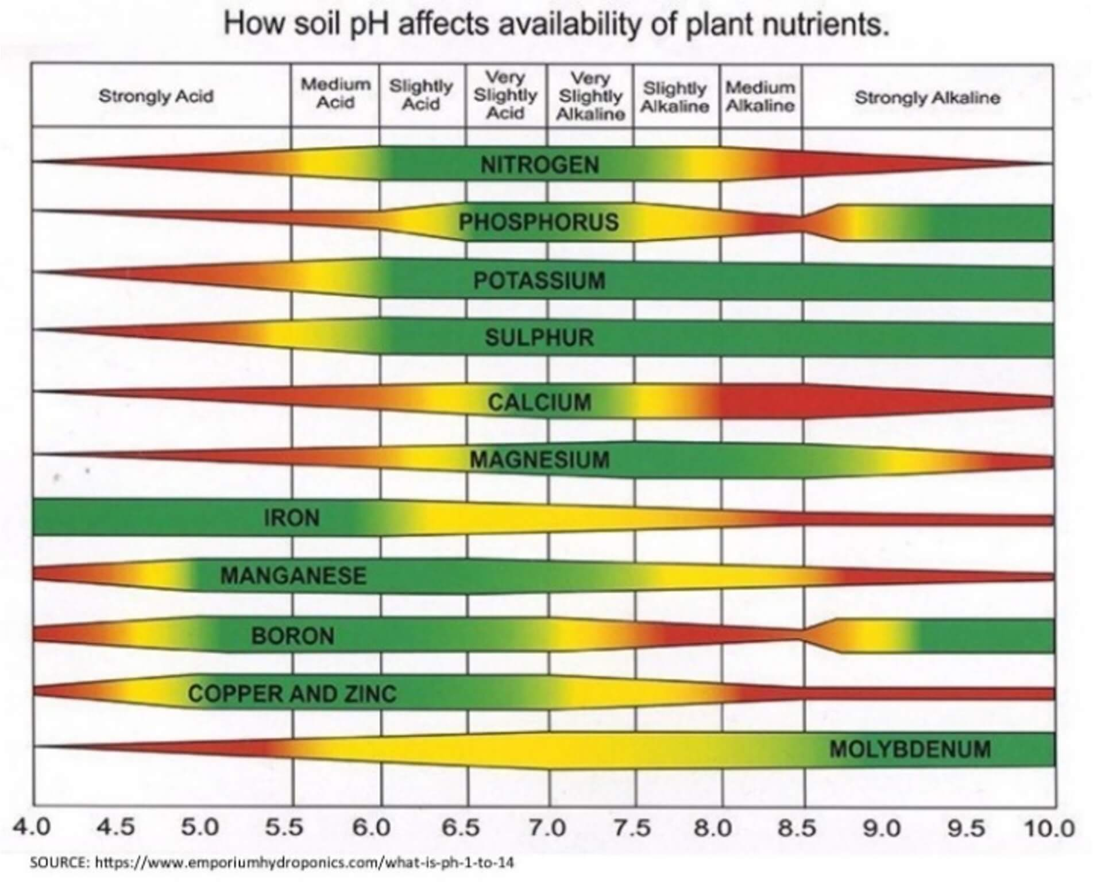
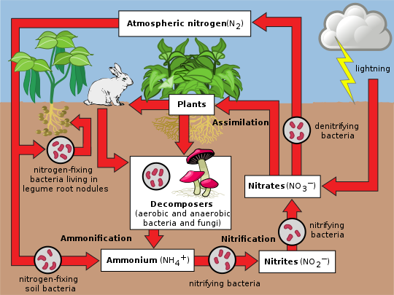
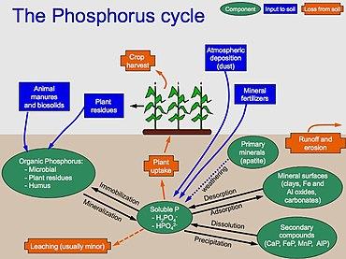
Rapitest Information
ph.
Nitrogen
Phosphorus

Slide 10
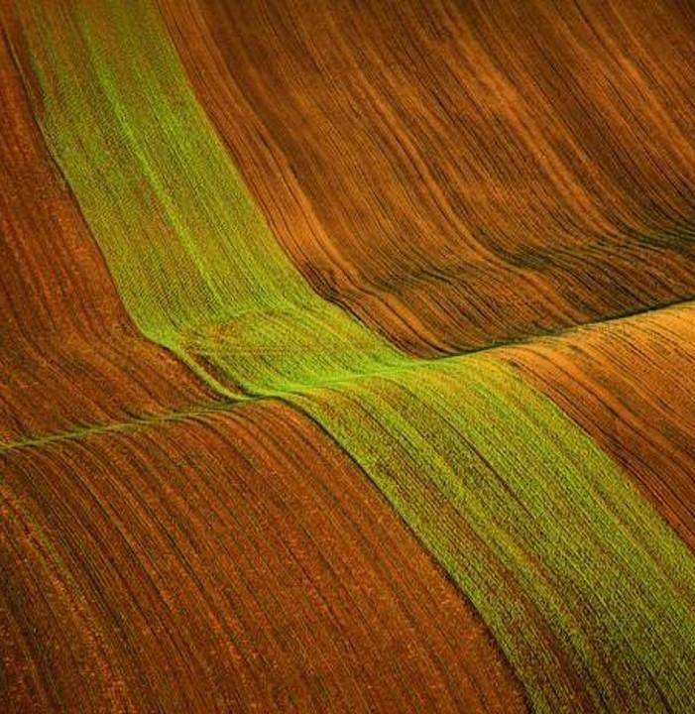
Thank you
If you would like a copy of this presentation Please let me know.
@kcougil@iu.edu

