Slide 1


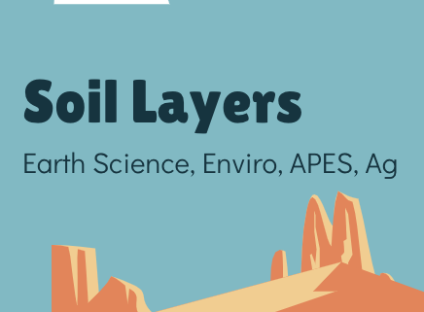
Discovering the Science of the Environment
Soil Layers Lesson
Center for Earth and Environmental Science
with support from National Resource Conservation Service

Slide 2

Soil Layers
Brought to you by CEES
Earth Science, Enviro, APES, Ag

Slide 3
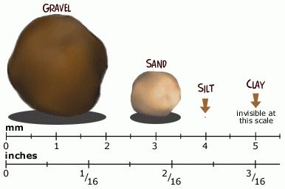
Types of Soil Particles
As soil is formed there are different size of soil particles. If the parent material and bedrock are made of very hard material it will create gravel and sand.
If the parent material and bedrock are made of softer material then silt and clay will end up in the soil.
What the soil is made up determines how well it holds water, air, and nutrients.

Slide 4
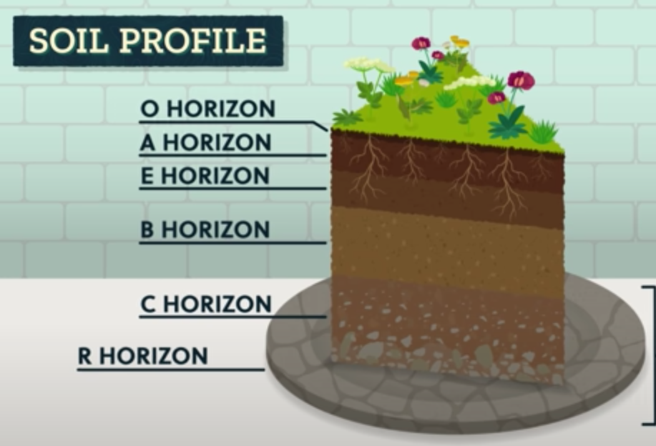
Soil Horizons
O = organic matter. Leaf litter, dead sticks, dead insects, dead grass
A = topsoil. Holds nutrients, water and air
E = the layer where the nutrients from A have leached down to (not all soils have an E horizon)
B = subsoil. Deep plant roots can be here. Less water and air trapped here. Denser soils with clay deposits.
C= Parent Material. Bigger rocks. Gravel can be mined from here. No nutrients or organic matter here
R Horizon = Bedrock= the base on which soil is formed. Bedrock can be hundreds of meters down or if weathering and erosion has taken place, can be exposed on the surface.

Slide 5
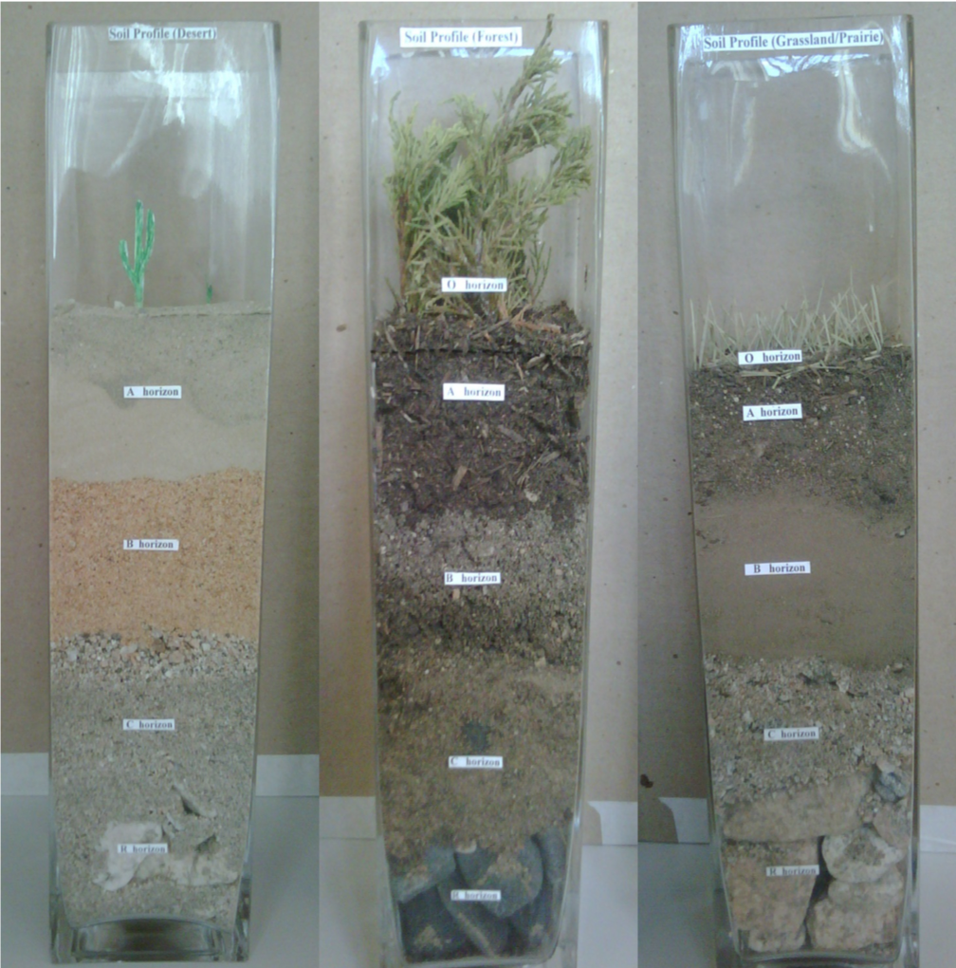
Observing Different Types of Soils
The teacher has set up various models of soil horizons.
Reminder: What is a model and why do we use them?
A three dimensional representation of a natural things (often on a smaller scale).
Things to think about: how might the models differ from soil in real life?
Walk around the room and observe.
Work on the Lab.

Slide 6

Development of this project was supported by:
Organization
Organization logo
Organization
Organization logo
For more information about the Center for Earth and Environmental Science and the Discovering the Science of the Environment program, go to:
https://cees.iupui.edu

