Slide 1


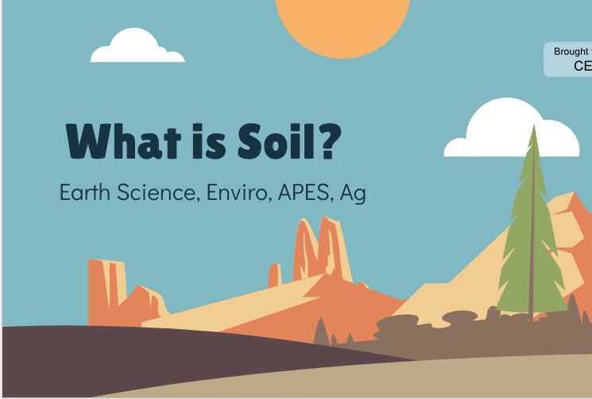
Discovering the Science of the Environment
Soil Formation & Matter Cycles Lesson
Center for Earth and Environmental Science
with support from Name of grant organization

Slide 2

What is Soil?
Brought to you by
CEES
Earth Science, Enviro, APES, Ag

Slide 3
Bell Ringer!
When we hike through the woods, drive by a cornfield, or mow our lawns, we tend to focus on the plants: the blooming flowers, the tassel-topped stalks, and the green grass borders. But what about the dirt? It seems soil is one of the planet’s most underappreciated natural resources.
Brainstorm 3 ways we use soil as a resource (Hint: one is listed in the paragraph above)

Slide 4
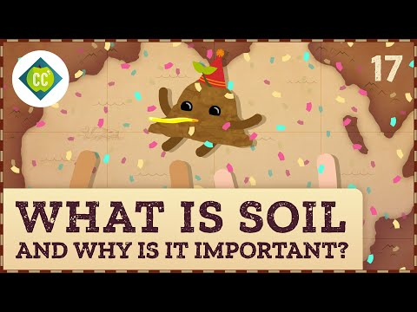
What is Soil? Crash Course Geography
Watch the video.
With your group write down important concepts and vocab from the video on your table whiteboard.
Pick 2 people to write down vocab words you don’t know
Pick 2 people to write down important main topics from the video.

Slide 5
That’s a lot to unpack! Let’s Discuss
What happened to the soil around the Aral Sea? How did this affect the local people?
What are the 4 components of soil?
Where are the nutrients of the soil located?
What is happening to the topsoil around the world?
Are all soils the same?
What new words did you hear that you don’t know the definition of? Let’s combine our words into one list
What is one important thing you learned from the video that we haven’t talked about so far.

Slide 6
How is soil formed?

Slide 7
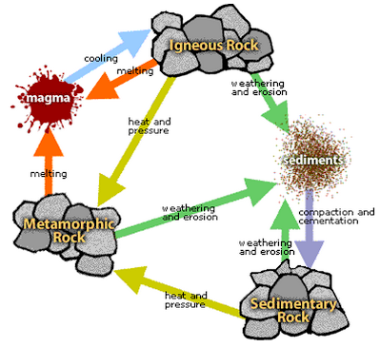
The Rock Cycle
Igneous Rocks are formed from cooling magma
Those rocks can be reheated and compressed to make Metamorphic Rocks
Both Igneous and Metamorphic Rocks can be broken down to create sediments
Sediments can become soil, or become compressed over long periods of time to become Sedimentary Rocks
Notes:
The rock cycle might have been covered in Earth Space Science during the Plate Tectonic Unit. Get a pulse on how well your students understand the rock cycle by asking them to describe the steps before showing the picture. If your students are unfamiliar, you might need to take more time here. The important part of the rock cycle is that rocks break down into other rocks. They need to know what Bedrock, Parent Material, and Sediments are before moving on.

Slide 8
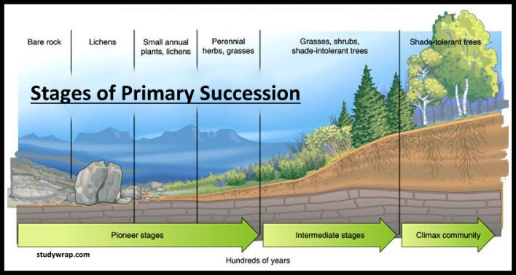
Ecological Succession & Soil Formation
Weathering & Erosion
Look at this soil formation!
Metamorphic or Igneous Rock
Accumulation of organic matter
Sedimentary rock
Notes:
Ecological Succession should have been covered in Biology: However if students are unfamiliar with the concept explain that this is how ecological communities are formed through the breakdown of rocks by lichens, weathering and eroding. This video goes into more detail: https://www.youtube.com/watch?v=vbgM54TXdnk

Slide 9

Is Soil a Renewable Resource?
What are renewable resources?
  those possible to use indefinitely without causing a reduction in supply
  Examples include fresh air, fresh surface water, most groundwater, fertile soil, elements that cycle through Earth, all living thing
What is a nonrenewable resource?
  exist in a fixed amount and can only be replaced by processes that take thousands of years.
  Examples include fossil fuels, gemstones, and elements such as gold, copper, and silver.

Slide 10
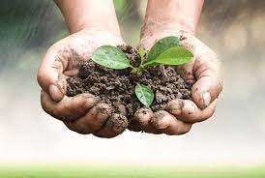
Is Soil A Renewable Resource?
What do we know?
Soil is made from rock
Soil can take 100’s to 1000’s of years to form
Soil has nutrients and living organisms
Are we using soil in sustainable ways?

Slide 11
Soil in Matter Cycles
Notes:
Some matter cycles might have been covered in Biology, such as the Water Cycle, Nitrogen, and Carbon Cycle. However, the Phosphorus Cycle and Sulfur Cycle might be new to students. Figure out what your students know with a pre-test or get a pulse on how fast they know the steps of the cycles. The point of the next few slides are to inform the students how nutrients get into the soil and that soil is an important part of matter cycling.
For the next couple of slides have students work to answer the discussion questions as a class, or in their table groups. If you are short on time, have each table group take a matter cycle and answer the questions. Then have them share out and present their answers to the rest of the class (JigSaw)

Slide 12
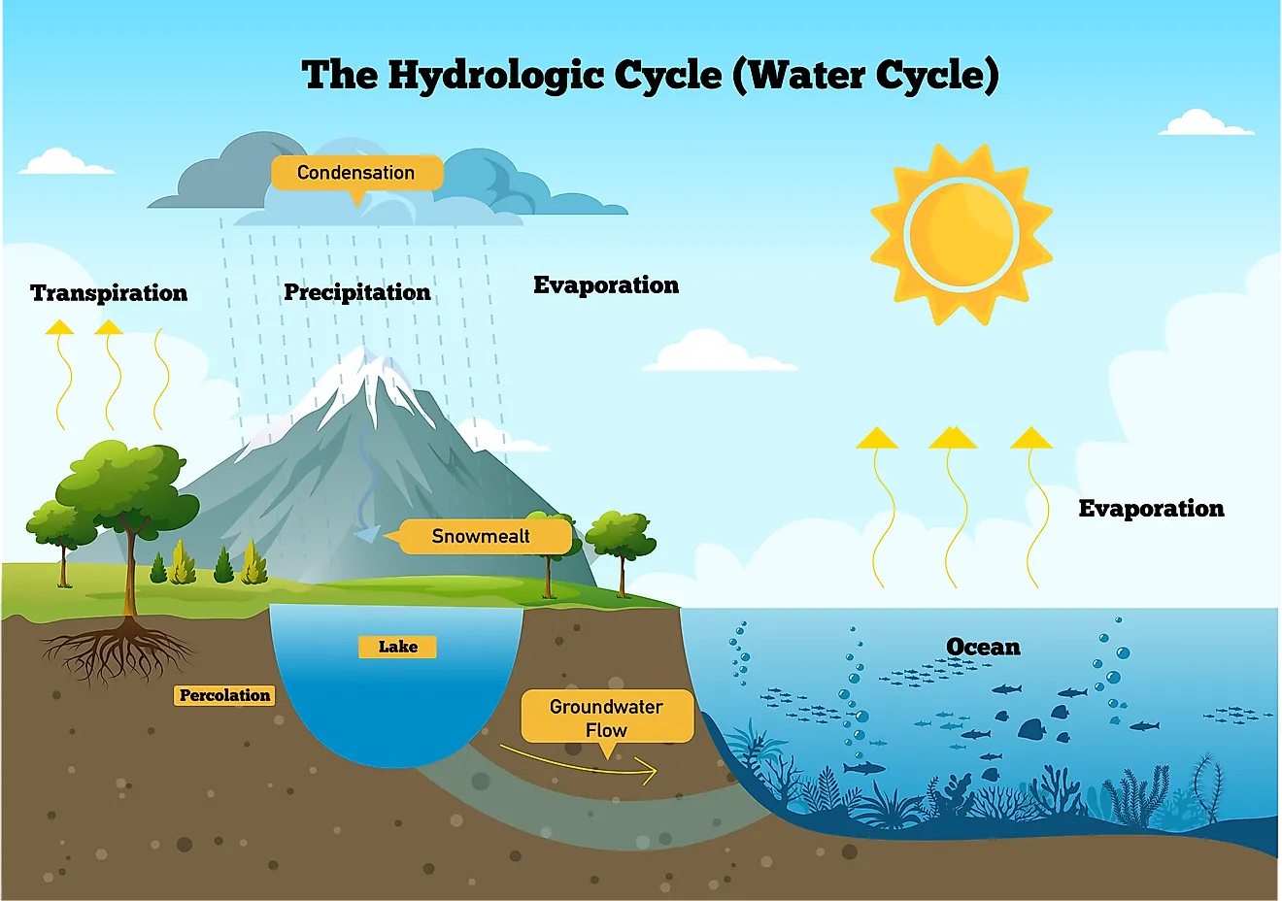
Water Cycle
How does the water get into the soil?
Once the water is in the soil, where does it go from there?
What might water carry with it into the soil? Think about what we put on our lawns.
As water runs off the mountain what processes is happening? (remember rock cycle)
How can water help make sedimentary rocks?
Big Question: Describe how the water cycle affects soil quality and nutrients.

Slide 13
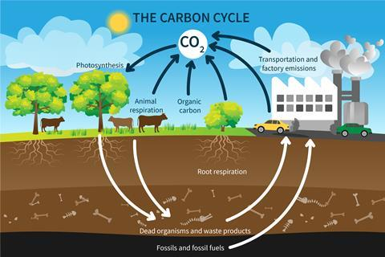
Carbon Cycle
How does the carbon get into the soil?
Once the carbon is in the soil, where does it go from there?
How long is carbon stored in soils?
How do plant roots use carbon?
What will happen if lots of carbon is released from soils?
Big Question: Describe how the carbon cycle affects soil quality and nutrients.

Slide 14
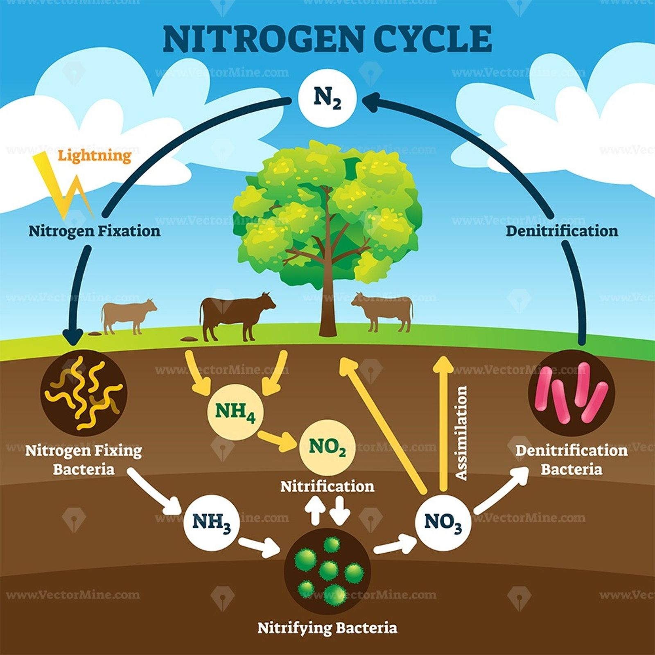
Nitrogen Cycle
Where does the majority of the Nitrogen Cycle take place?
How does the nitrogen get into the soil?
Once the nitrogen is in the soil, where does it go from there?
How do plant roots use nitrogen?
What will happen if there is not enough nitrogen in the soil?
How can we put more nitrogen in the soil?
Big Question: Describe how the nitrogen cycle affects soil quality and nutrients.

Slide 15
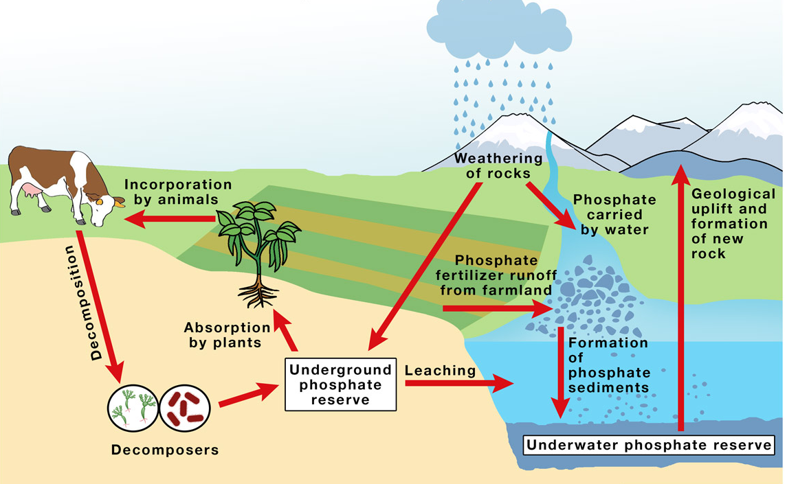
Phosphorus Cycle
Where is Phosphorus stored?
How does the phosphorus get into the soil?
Once the phosphorus is in the soil, where does it go from there?
How do plant roots use phosphorus?
What will happen if there is not enough phosphorus in the soil?
How can we put more phosphorus in the soil?
Big Question: Describe how the phosphorus cycle affects soil quality and nutrients.

Slide 16
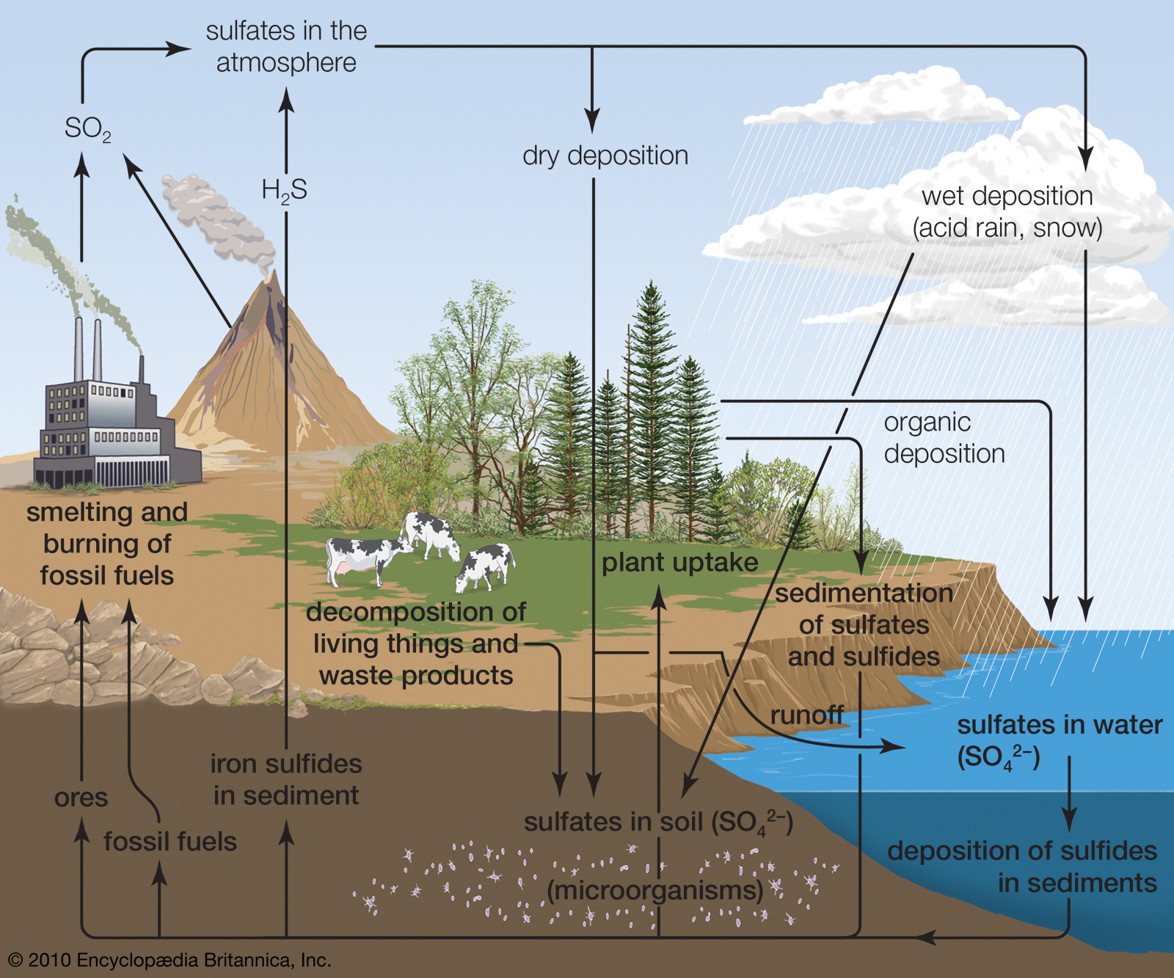
Sulfur Cycle
Sulfur is a nutrient that is important to plants, just like Nitrogen and Phosphorus. What will happen if there is not enough sulfur in the soil?
How does Sulfur get into the soil?
Once the Sulfur is in the soil, where does it go from there?
There has been a shortage of Sulfur since environmental regulations have been put into place to limit SO2, where else can sulfur come from?
Big Question: Describe how the sulfur cycle affects soil quality and nutrients.

