Slide 1
Climate Zones
How the Atmosphere, Ocean & Cryosphere interact to create climate
Notes:
If you are doing this as practice or a class activity. Share this PowerPoint with students. They can open it on their device, digitally pick a slide and work on it. When everyone is done, they can present their slide (digital poster) to the class. In a larger class have students work in pairs.

Slide 2
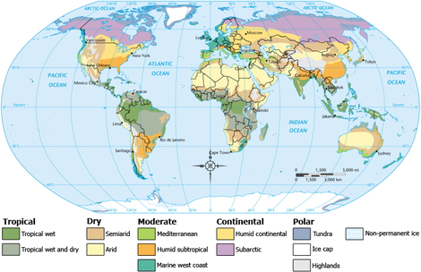
Your Task
In pairs you will be responsible for selecting a climate zone and doing the research outlined on the slides.
Make sure you include a picture of where your climate zone is located on a map.
Let’s take a look at an example before we get started

Slide 3
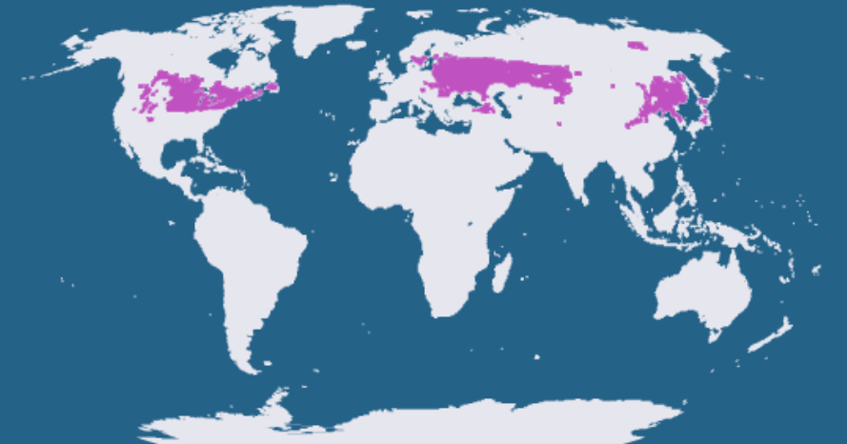
Humid Continental
Precipitation: Gets precipitation all year as either rain or snow
Temperature: Hot summers and cold winters
Plants: Cottonwood, ash, cherry, weeping willow, birch.
How does the Atmosphere, Ocean & Cryosphere work together to create the climate zone?
Atmosphere - warm wet air comes from the distant oceans. The warmer the atmosphere the more water it can hold and is humid - low pressure - clouds
Ocean - The oceans circulate warm water from the equator which warms the air farther north. Water evaporates from the ocean to make maritime tropical air mass
Cryosphere - the snow and ice of the polar ice caps cools the air which moves south. As the northern hemisphere cools it decreases winter temperatures and snow can form as precipitation
How will the climate zone change due to global warming?
Humid continental will get hotter and drier with winters more like coastal humid continental and summers more like humid subtropical. There will be increased storms and extreme weather events such as tornadoes. Even though it is humid continental, there will be more droughts as a result of rising air temperatures.

Slide 4
Tropical Wet - Name
Precipitation:
Temperature:
Plants:
How does the Atmosphere, Ocean & Cryosphere work together to create the climate zone?
Atmosphere -
Ocean -
Cryosphere -
How will the climate zone change due to global warming?
Insert Picture Here

Slide 5
Tropical Wet & Dry - Name
Precipitation:
Temperature:
Plants:
How does the Atmosphere, Ocean & Cryosphere work together to create the climate zone?
Atmosphere -
Ocean -
Cryosphere -
How will the climate zone change due to global warming?
Insert Picture Here

Slide 6
Semiarid - Name
Precipitation:
Temperature:
Plants:
How does the Atmosphere, Ocean & Cryosphere work together to create the climate zone?
Atmosphere -
Ocean -
Cryosphere -
How will the climate zone change due to global warming?
Insert Picture Here

Slide 7
Arid - Name
Precipitation:
Temperature:
Plants:
How does the Atmosphere, Ocean & Cryosphere work together to create the climate zone?
Atmosphere -
Ocean -
Cryosphere -
How will the climate zone change due to global warming?
Insert Picture Here

Slide 8
Mediterranean - Name
Precipitation:
Temperature:
Plants:
How does the Atmosphere, Ocean & Cryosphere work together to create the climate zone?
Atmosphere -
Ocean -
Cryosphere -
How will the climate zone change due to global warming?
Insert Picture Here

Slide 9
Humid Subtropical - Name
Precipitation:
Temperature:
Plants:
How does the Atmosphere, Ocean & Cryosphere work together to create the climate zone?
Atmosphere -
Ocean -
Cryosphere -
How will the climate zone change due to global warming?
Insert Picture Here

Slide 10
Marine West Coast - Name
Precipitation:
Temperature:
Plants:
How does the Atmosphere, Ocean & Cryosphere work together to create the climate zone?
Atmosphere -
Ocean -
Cryosphere -
How will the climate zone change due to global warming?
Insert Picture Here

Slide 11
Subarctic - Name
Precipitation:
Temperature:
Plants:
How does the Atmosphere, Ocean & Cryosphere work together to create the climate zone?
Atmosphere -
Ocean -
Cryosphere -
How will the climate zone change due to global warming?
Insert Picture Here

Slide 12
Tundra - Name
Precipitation:
Temperature:
Plants:
How does the Atmosphere, Ocean & Cryosphere work together to create the climate zone?
Atmosphere -
Ocean -
Cryosphere -
How will the climate zone change due to global warming?
Insert Picture Here

Slide 13
Ice Cap - Name
Precipitation:
Temperature:
Plants:
How does the Atmosphere, Ocean & Cryosphere work together to create the climate zone?
Atmosphere -
Ocean -
Cryosphere -
How will the climate zone change due to global warming?
Insert Picture Here

Slide 14
Highlands- Name
Precipitation:
Temperature:
Plants:
How does the Atmosphere, Ocean & Cryosphere work together to create the climate zone?
Atmosphere -
Ocean -
Cryosphere -
How will the climate zone change due to global warming?
Insert Picture Here

