Slide 1
Aspects of Climate
Cryosphere

Slide 2
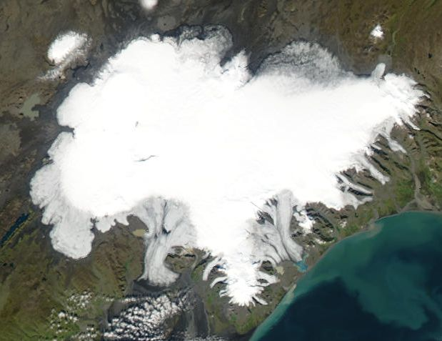
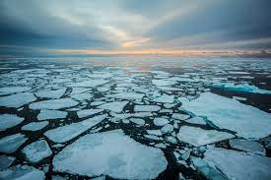
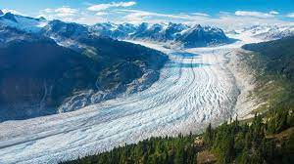
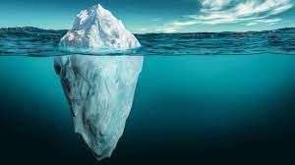
What is the cryosphere made of?
List as many things as you can remember that make up the cryosphere

Slide 3
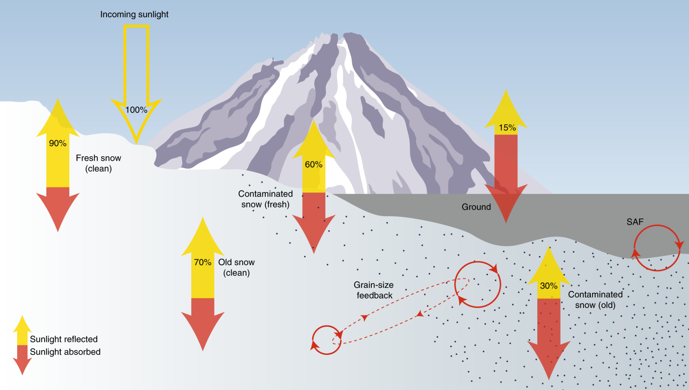
Why is the cryosphere cold?
Remember the poles get less direct sunlight - resulting in colder temperatures
This creates ice and snow which has a high albedo and reflects light back to space
This makes the poles even colder, which makes more ice and snow
Which reflects more light back in to space…

Slide 4
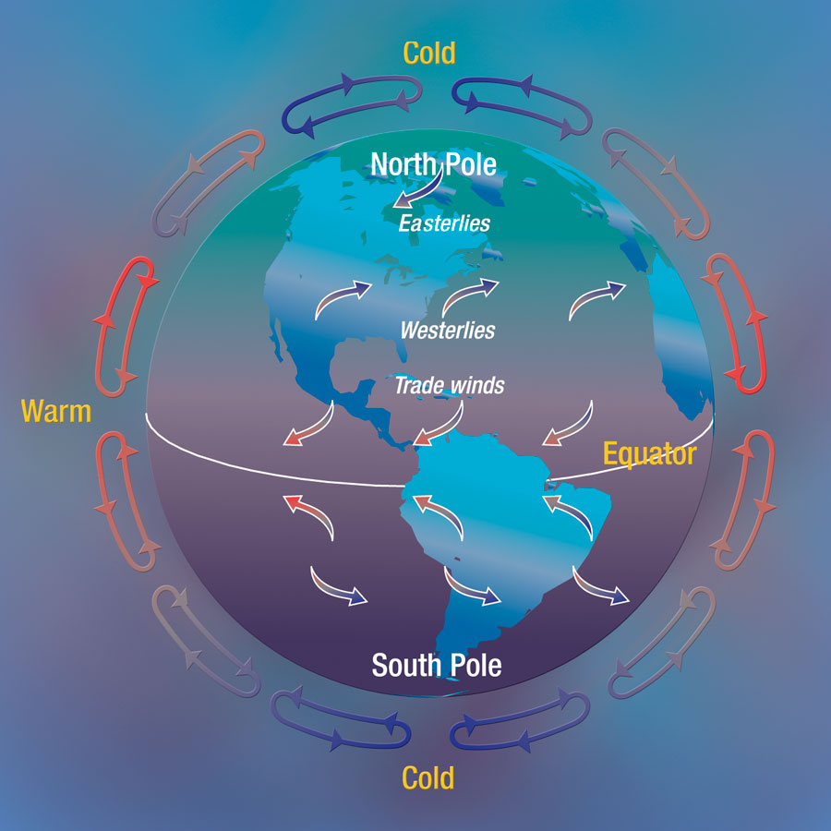
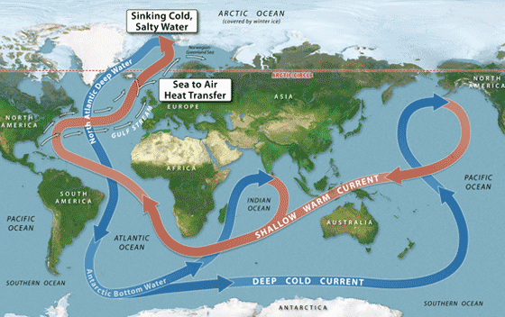
How does the cryosphere affect climate?
Without the cryosphere the whole planet would be a lot warmer! It acts like the air conditioning unit for the planet
Air circulates to the poles and becomes cold and dry. This air contributes to continental polar air masses and high pressure
Water circulates to the poles and becomes cold. This pulls the global conveyor belt deep and keeps ocean currents circulating. Cold water evaporates less and creates drier climates.

Slide 5
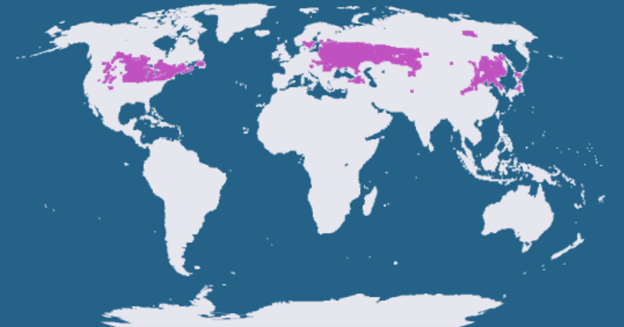
How does cryosphere affect climate zones?
Explain how the cryosphere effects the Humid Continental Climate Zone
Cryosphere connection: the ice is a source that cools the air. Then then travels south toward the humid continental climate zone.
Atmospheric connection review: This cP air meets with other air mass(es) to create fronts. Fronts uplift the air → dew point → clouds → precipitation

Slide 6
How does climate change affect the cryosphere?
Melting Ice sheets
Melting Sea Ice
Decrease albedo
Sea level rise

Slide 7
How do we know the cryosphere is melting?
Remember chasing ice?
Add pictures of glaciers melting

Slide 8
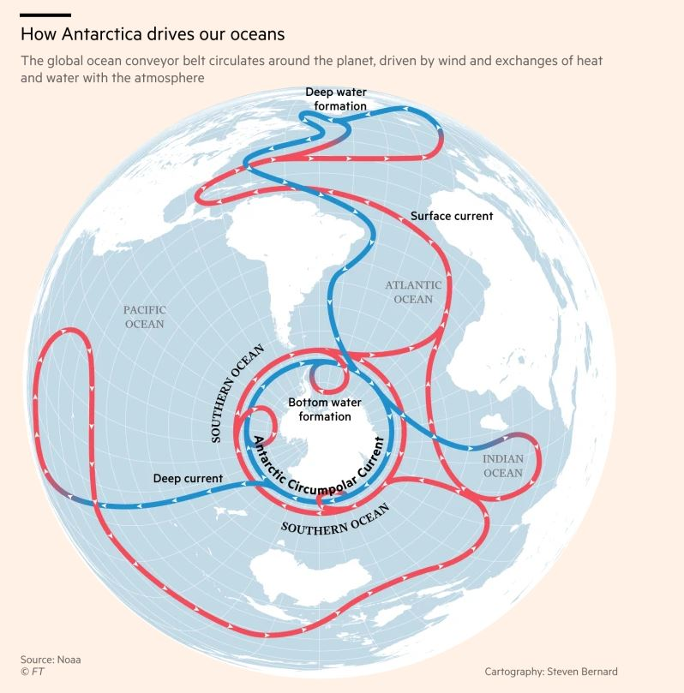
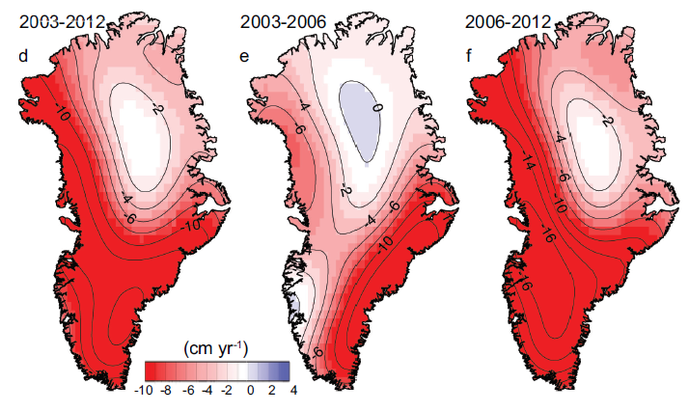
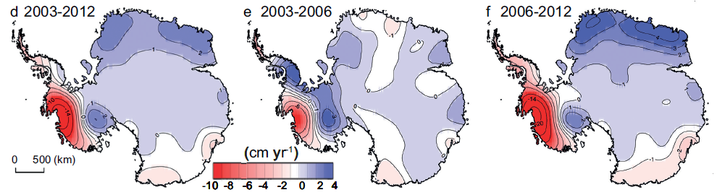
Melting Ice Sheets
Increased air temperatures melt ice
Why is Greenland melting faster than Antarctica?
The northern hemisphere is warming faster than the southern… why?
The southern hemisphere has more water and stays cooler
Antarctic circumpolar current keeps things cold down there

Slide 9
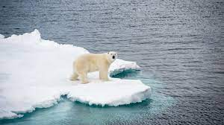
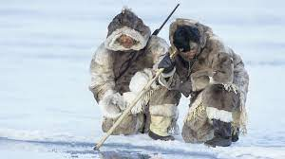
Melting Sea Ice
Affects animals and people that depend on the sea ice for hunting
Will melting sea ice increase sea level?
(Answer to come in our lab today)

Slide 10
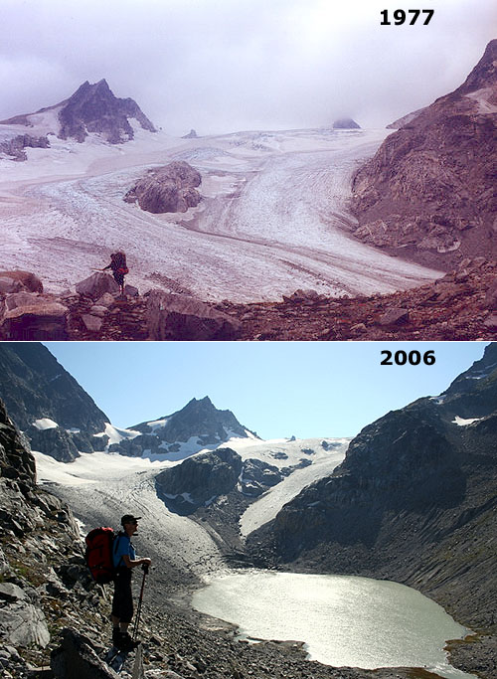
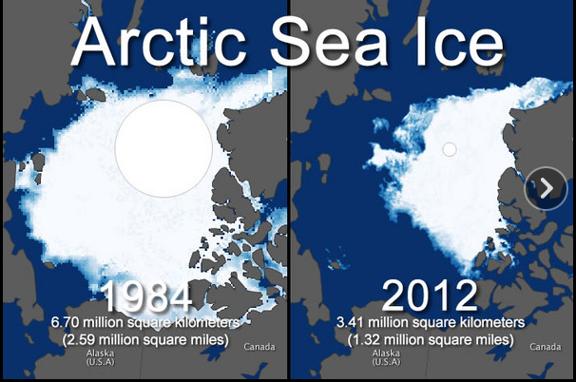
Melting ice decreases albedo
Decrease in albedo traps heat (because of the dark color) which melts more ice

Slide 11
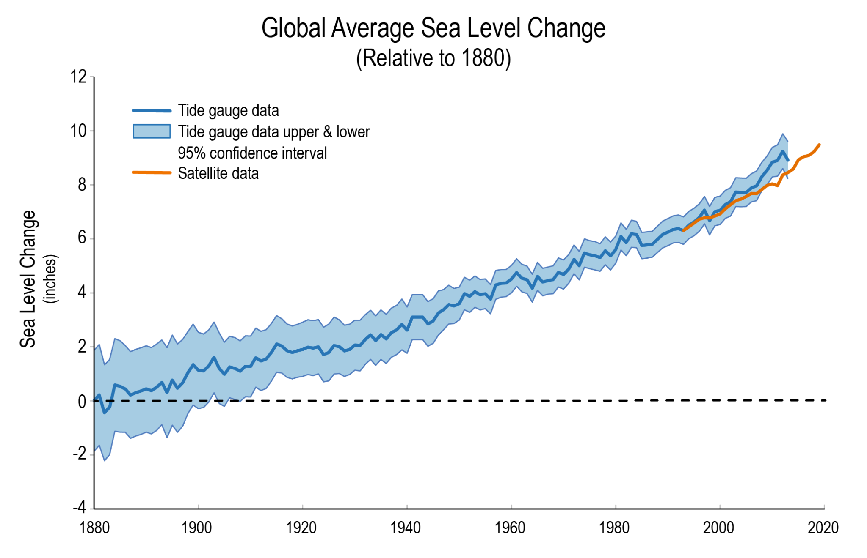
Sea Level Rise
Sea level rise is projected to reach 1 foot by 2050. This might not seem like a lot, but one foot of ocean water will impact 40% of U.S. populations.
This includes housing, industry, and agriculture

