Slide 1
How to Interpret Climate Data

Slide 2
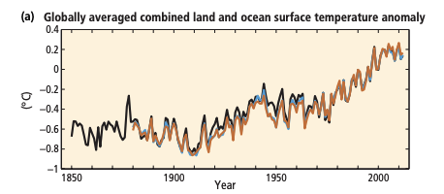
Pay attention to the X and Y axis
What year does this data start?
Why is the temperature range so small?
What does an anomaly mean?

Slide 3
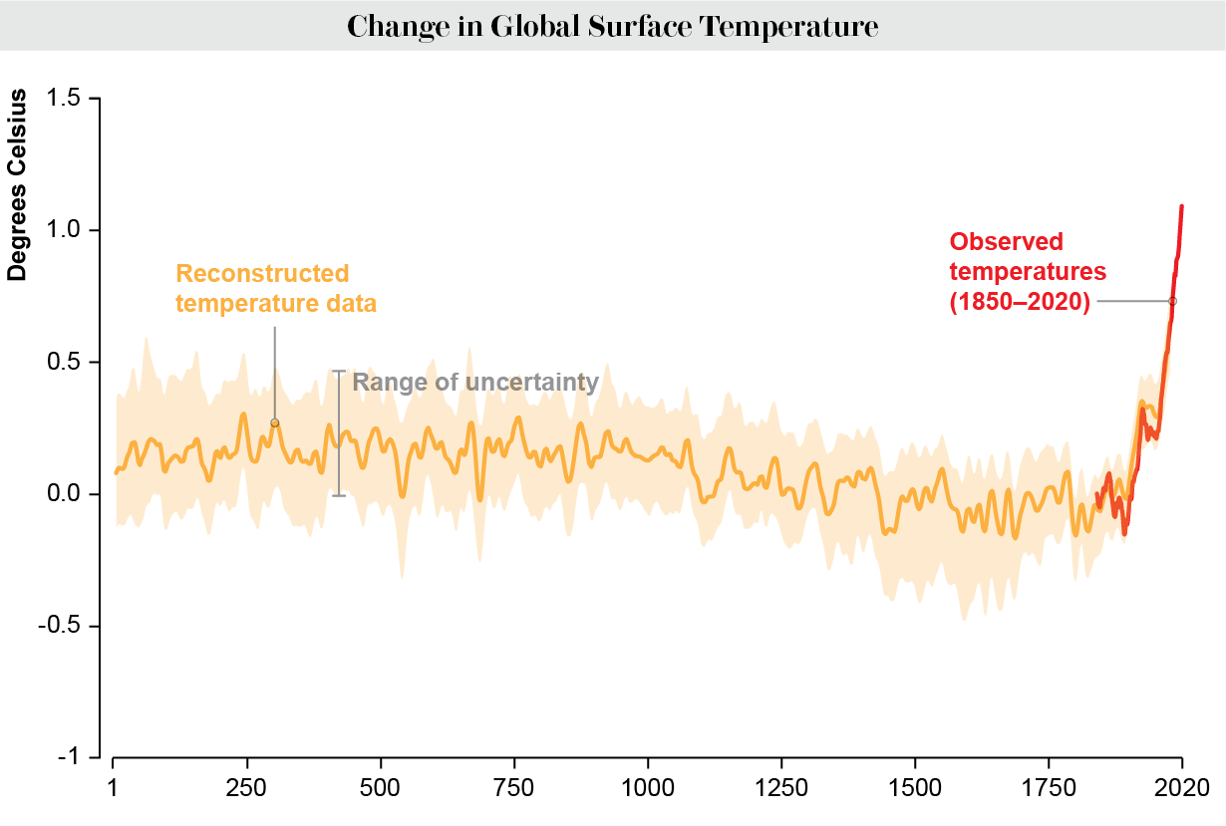
Pay attention to the X and Y axis
When does this graph start?
What is the range of uncertainty?
Where did the temperature data come from before there were instruments?

Slide 4
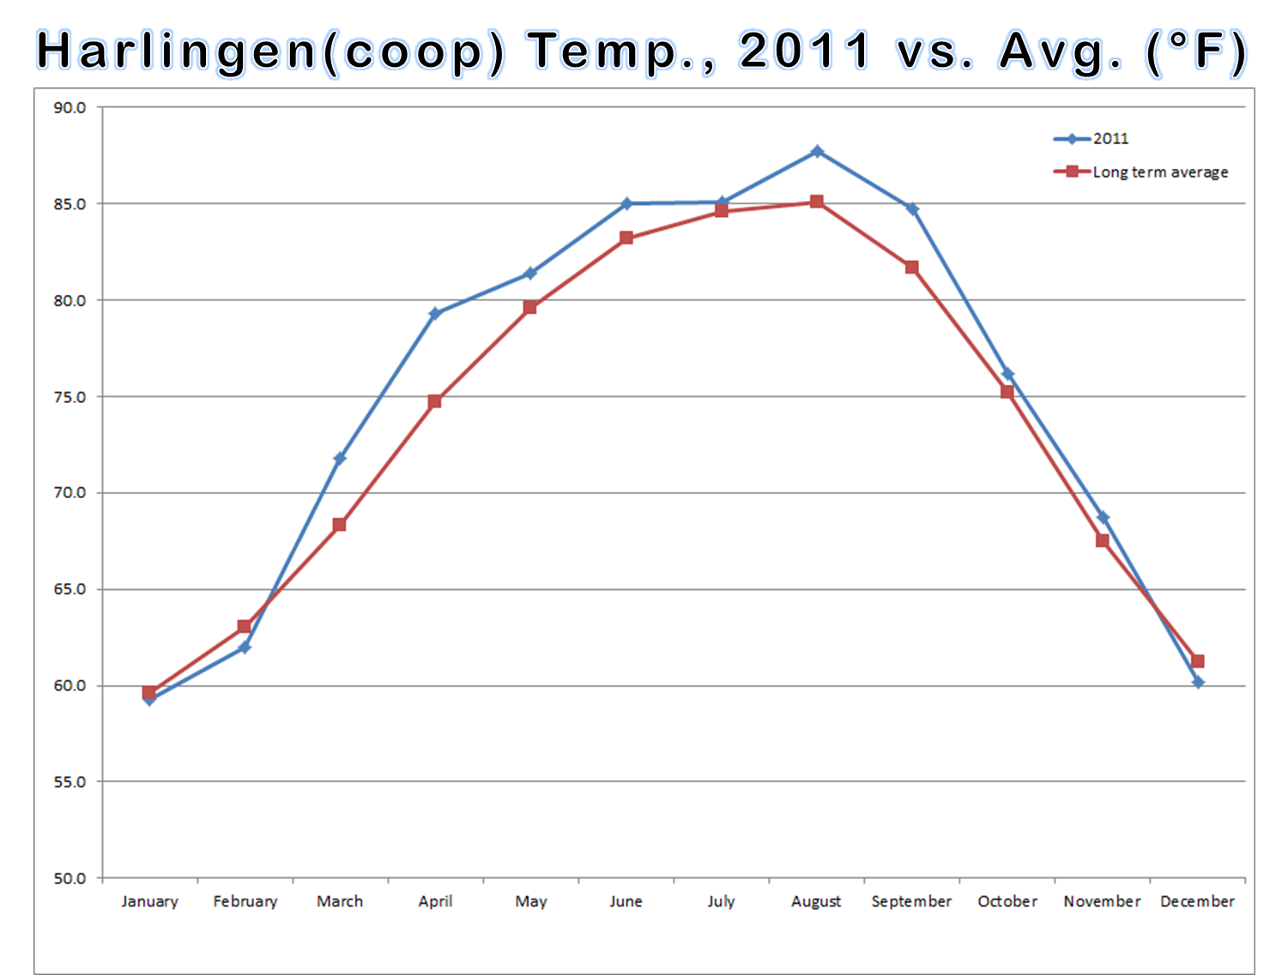
Pay attention to the X and Y axis
When does this graph start?
Why is it important to look at the time scale when thinking about climate change?
Can we look at a single day temperature and say whether climate change is happening?

Slide 5
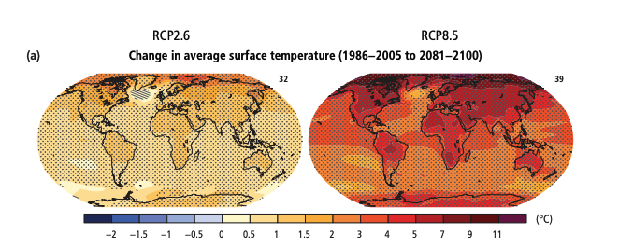
Pay attention to the title and the key
What is this graph measuring?
What does the blue area mean?

Slide 6
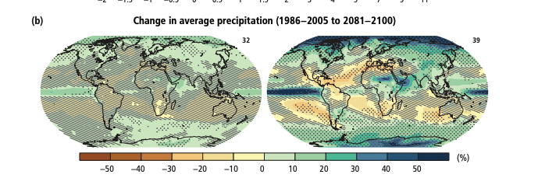
Pay attention to the title and the key
What is this graph measuring?
What does the blue area mean?

Slide 7
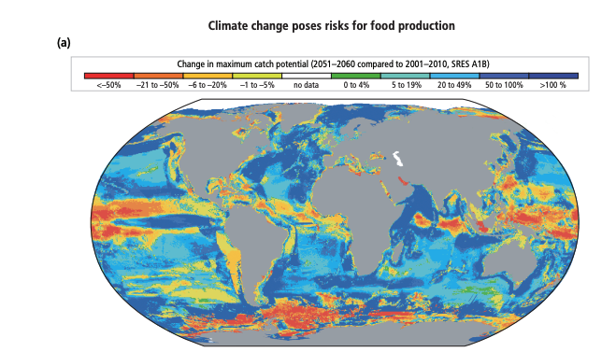
Pay attention to the title and the key
What is this graph measuring?
What does the blue area mean?

Slide 8
What is the Trend? (the pattern in the data)
What is the trend of this graph? Is it positive, negative, stays the same?

Slide 9
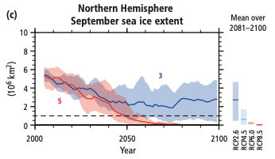
What is the Trend? (the pattern in the data)
What is the trend of this graph? Is it positive, negative, stays the same?

Slide 10
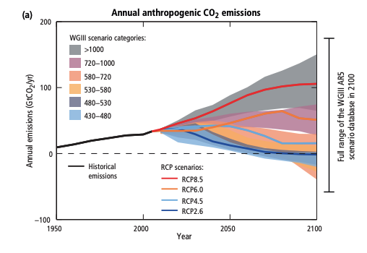
Why are there multiple lines on this graph?
Sometimes different lines mean different scenarios.
How do scientists predict that humans will curb their emissions in the future

Slide 11
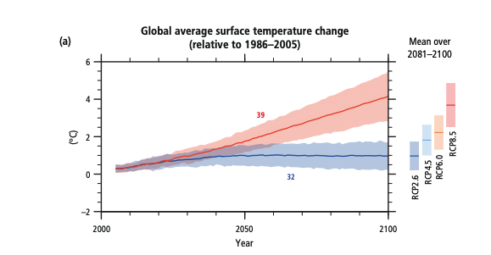
Why are there multiple lines on this graph?
Sometimes different data comes from different climate models and report slightly different findings.
Remember that climate is very complicated, change one variable and many other outcomes can change

