Slide 1
Introduction to Climate

Slide 2
What is climate?
Weather - The condition of Earth’s atmosphere at a particular time and place
Seasons - a time of the year marked by particular weather patterns and daylight hours, resulting from the earth's changing position with regard to the sun.
Climate variation - short-term changes in climate that take place over months, seasons and years. This variability is the result of natural, large-scale features of the climate
Climate change - a change in climate patterns from that can occur across decades to millions of years
Climate - the AVERAGE weather conditions in a location over a long period of time (30 years)

Slide 3
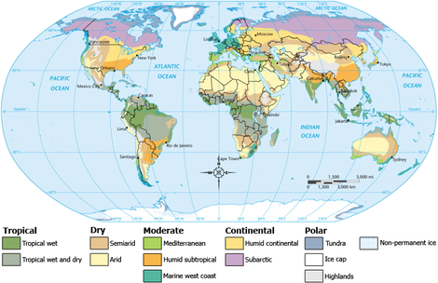
There are 12 different climate zones on the Planet

Slide 4
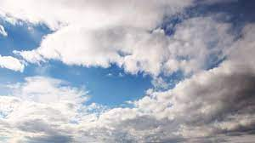
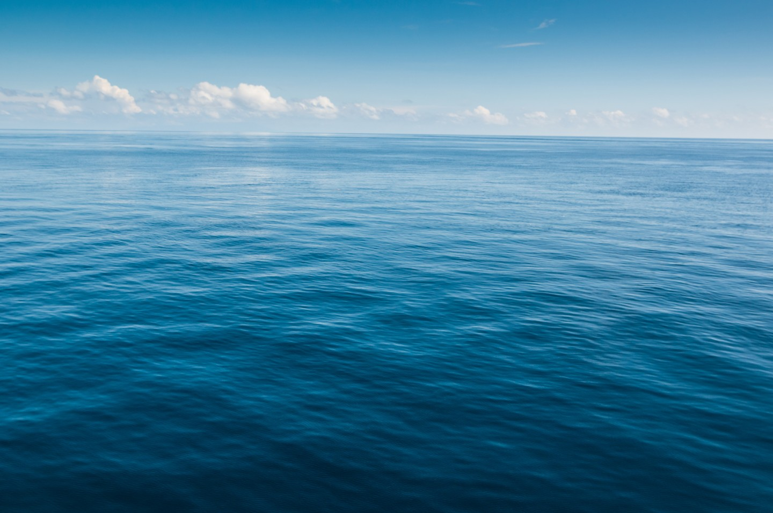
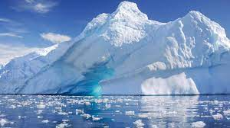
How are Climates formed?
Interaction between the hydrosphere, atmosphere, and cryosphere

Slide 5
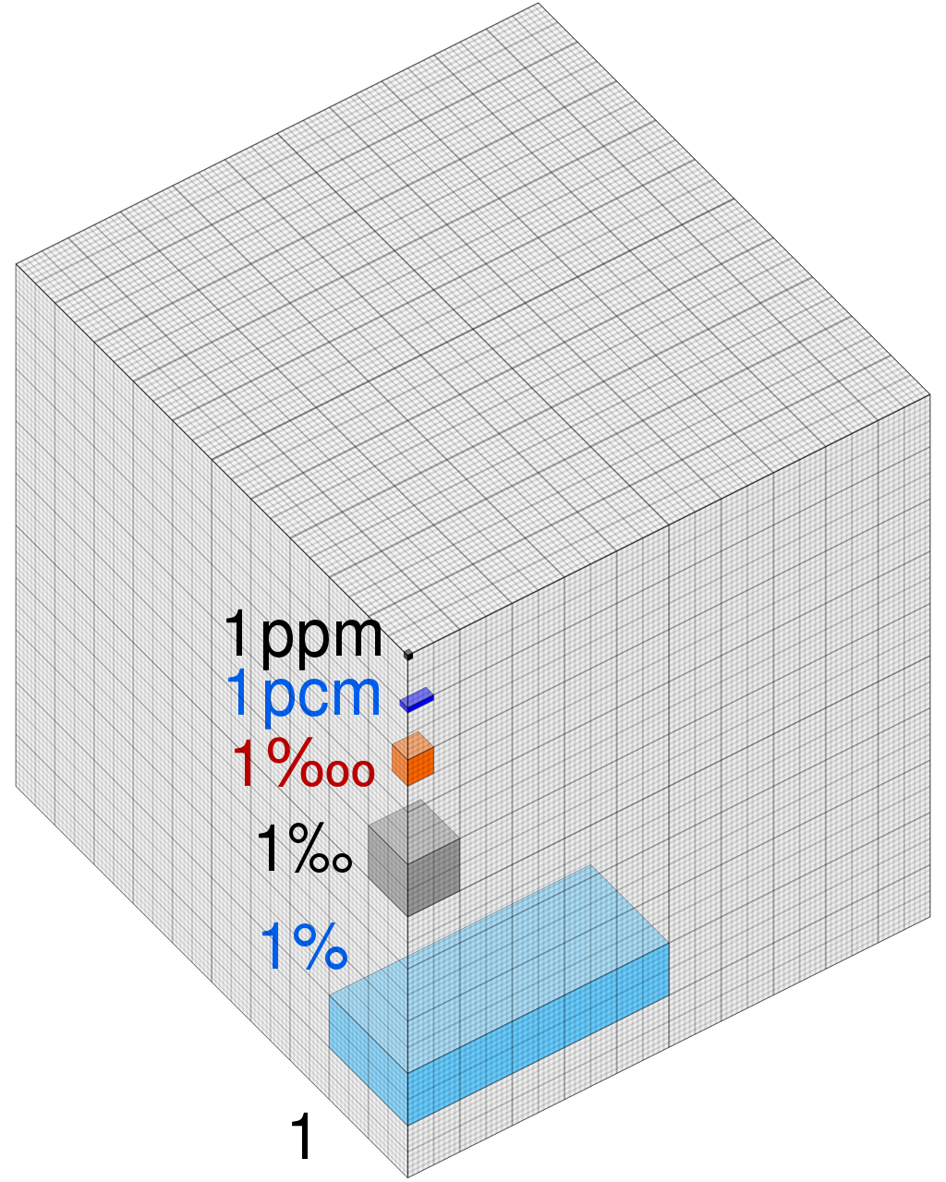
Atmosphere
Remember what the atmosphere is made of
78% Nitrogen
21% Oxygen
400 ppm Carbon Dioxide

Slide 6
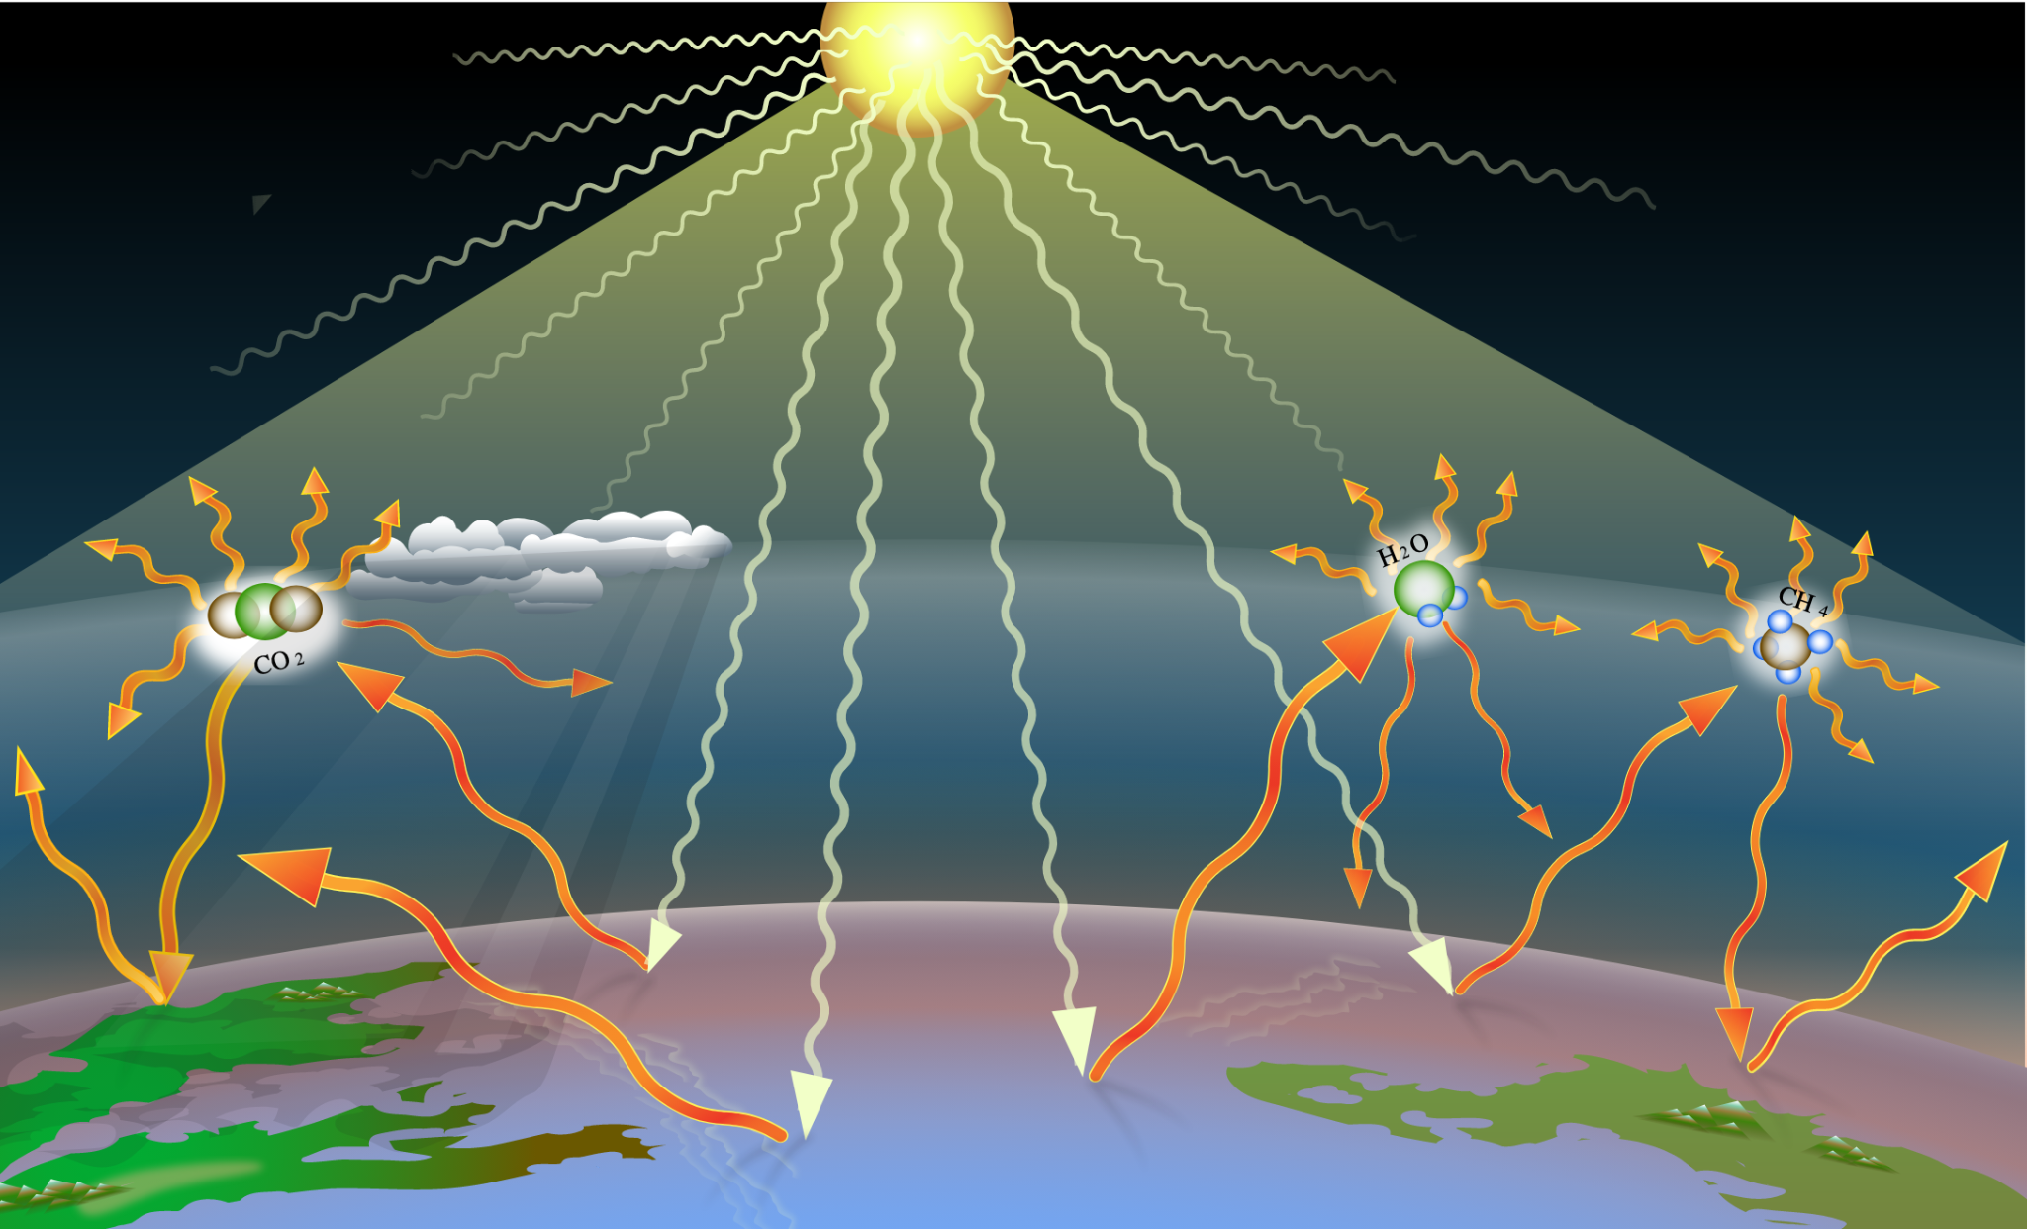
Atmosphere
How does CO2 affect the atmosphere?
What would happen if there were too little CO2?
What would happen if there were too much CO2?

Slide 7
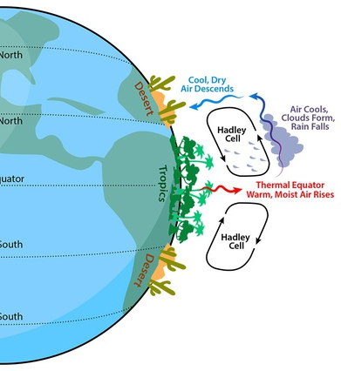
Atmosphere
Uneven heating of the earth creates circulating air cells
Hot air rises - low pressure - rain
Cold air falls - sunny - dry
Warm air comes away from the equator
Cold air comes away from the poles
The circulation of the atmosphere distributes carbon dioxide evenly around the globe

Slide 8
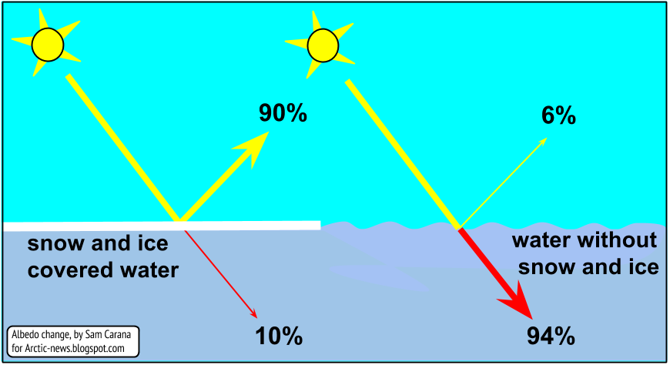
Oceans
The oceans has absorbed 90% of the heat gained by the planet
Without the oceans the planet would be about 122° F
The ocean is dark in color and has a low albedo. Absorbs light and traps heat

Slide 9
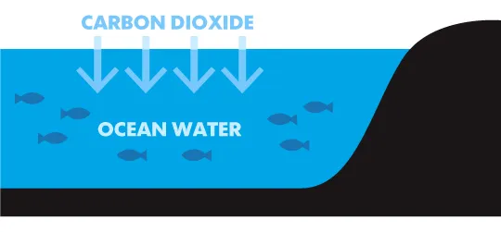
Oceans
The Ocean holds 50X as much Carbon Dioxide as the atmosphere
Carbon Dioxides comes out of the atmosphere and can get caught in the ocean to be stored for a period of time.
Warmer waters don’t hold as much carbon dioxide as cold water

Slide 10
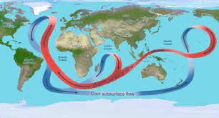
Oceans
Ocean circulation distributes heat and carbon dioxide around the planet
Warm water moves away from the equator
Cold water moves away from the poles
Water temperature determines the climate of coastal regions
Remember how the UK was warmer than Alaska, but they were at the same latitude?

Slide 11
Cryosphere
What is the cryosphere? The region of the Earth’s water and soil that is frozen
Benefits of ice
High albedo reflects light and keeps the area cool
Ice cools the air and oceans which circulate cool air and water around the planet
Traps water to keep ocean level down
Ice traps CO2 that had been circulating in the ocean and the atmosphere

Slide 12
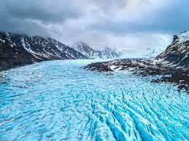
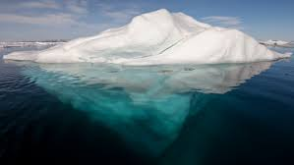
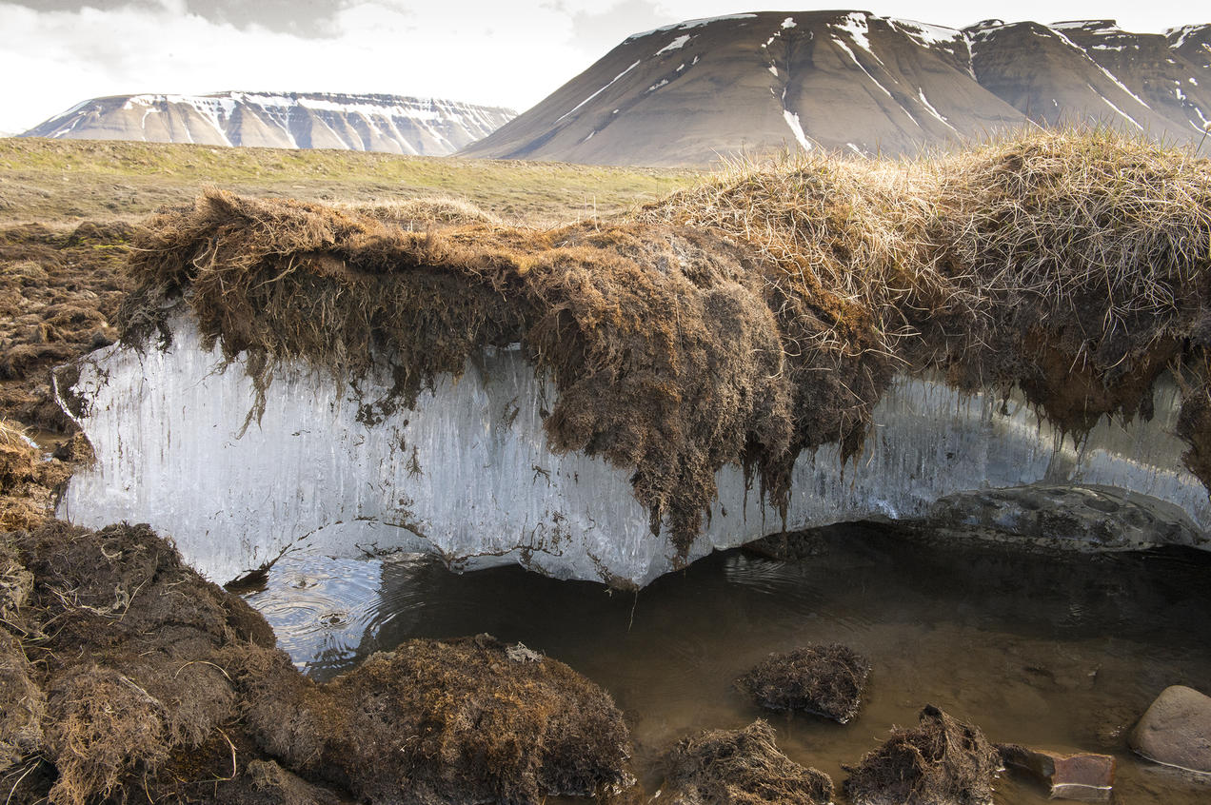
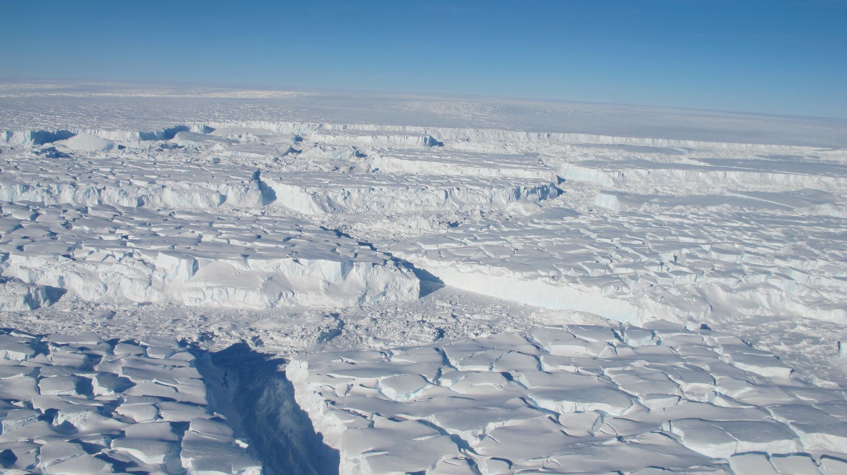
Cryosphere
Glaciers - large frozen rivers - usually terminate at the ocean
Ice Sheets - large areas of land covered in ice. Bigger than glaciers and icebergs
Ice Bergs - Ice in the Ocean
Permafrost - frozen soil. Traps a lot of carbon dioxide and methane.

